Slide 1
EDCO Conference Session Review: Investment Evaluation on the Back of a Napkin
Ted L. Davis, CCIM, SIOR
Principal & Chief Operating Officer, Canada

Slide 2
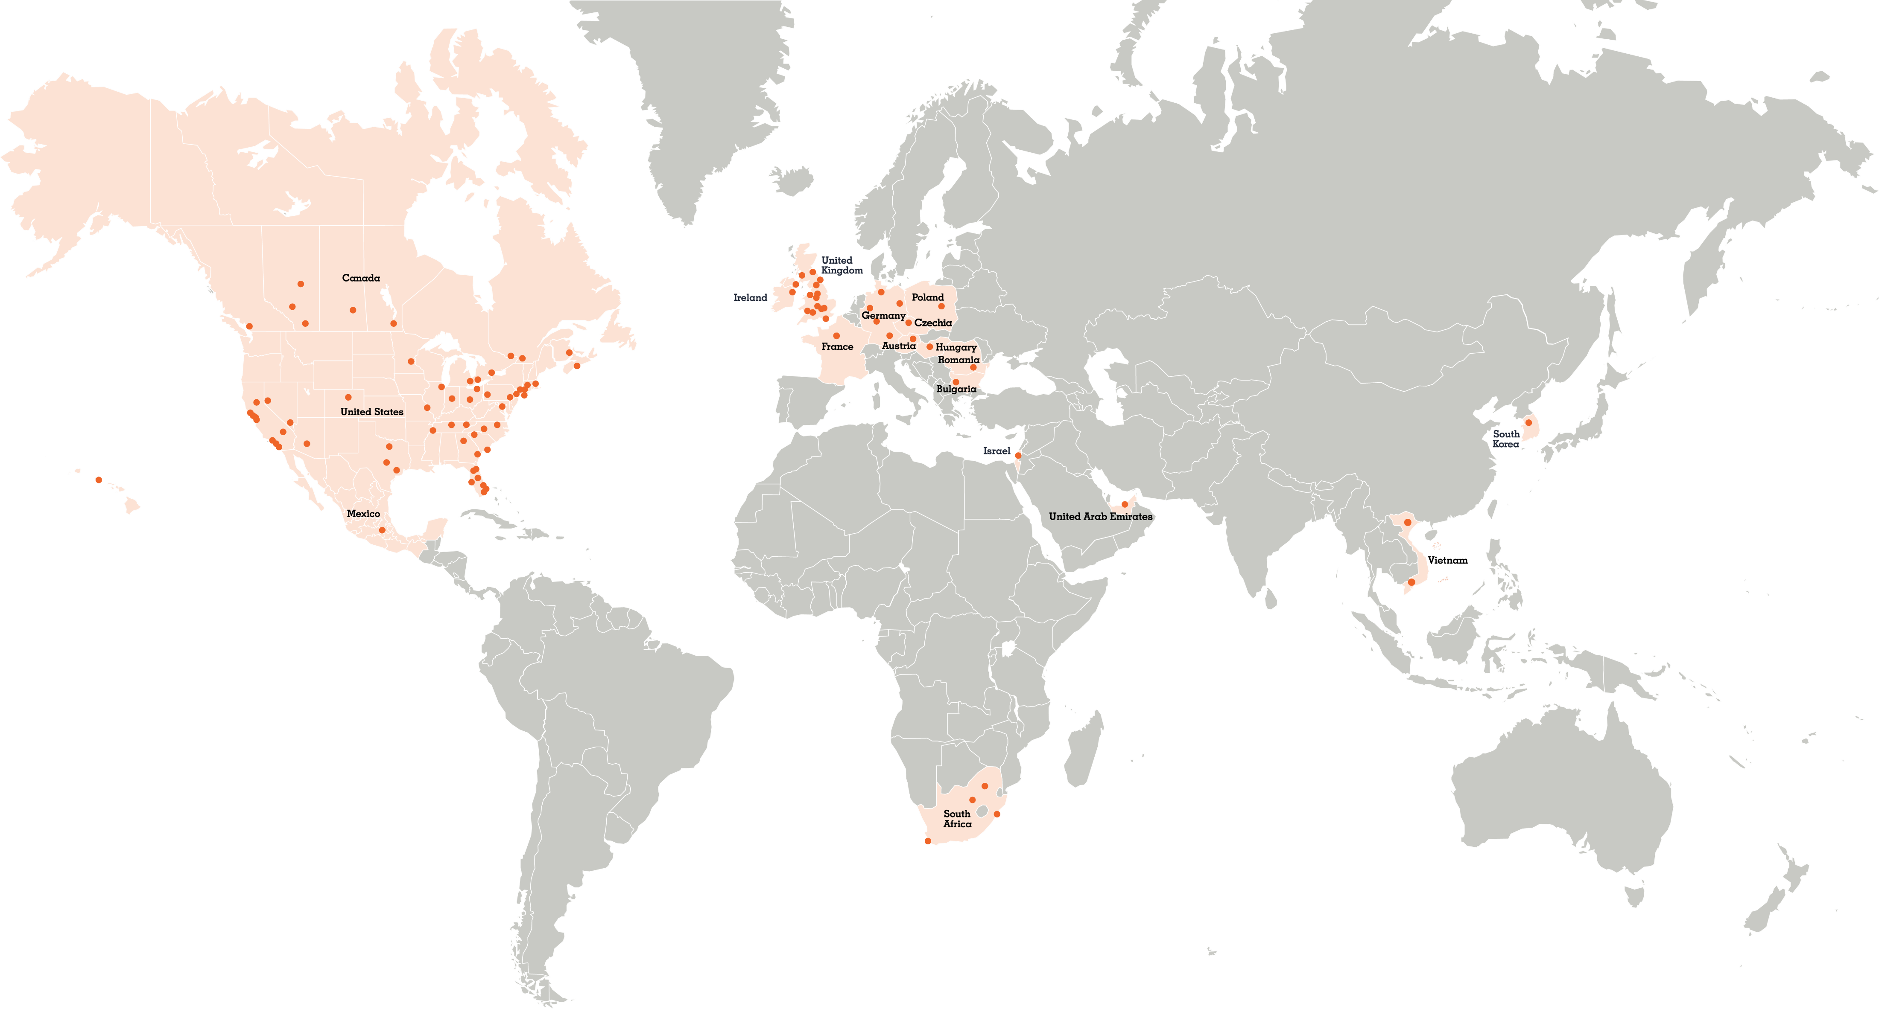
AT A GLANCE
Our global presence
5,000
18
283M
100+
real estate professionals
countries worldwide
square feet under property management
offices across the world

Slide 3
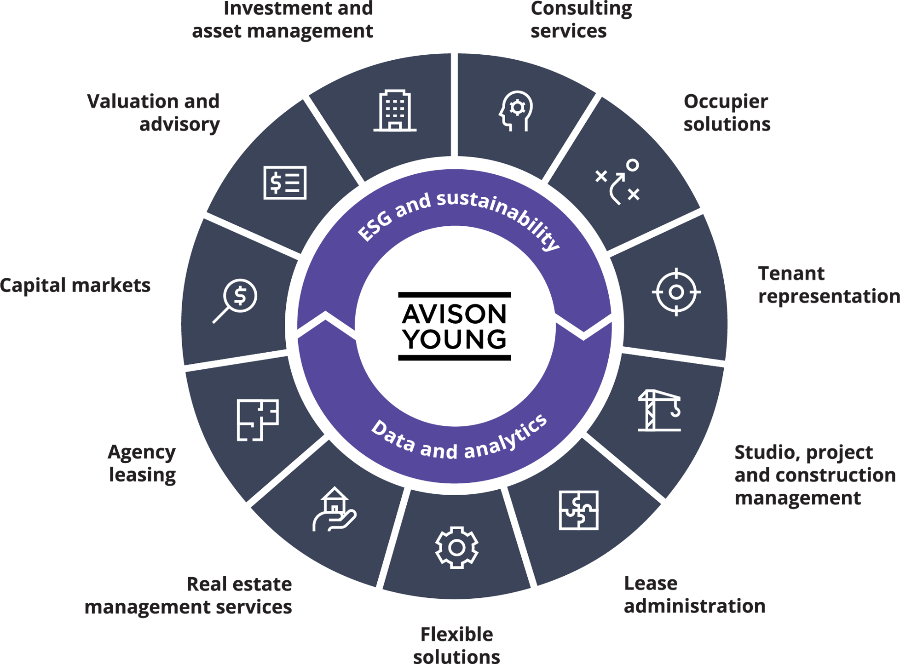
What we do
Avison Young offers a comprehensive suite of commercial real estate services. We’ve designed our corporate structure to best serve our clients by enhancing collaboration across our organisation.
Our firm is organised to deliver truly integrated solutions to meet your unique needs.

Slide 4
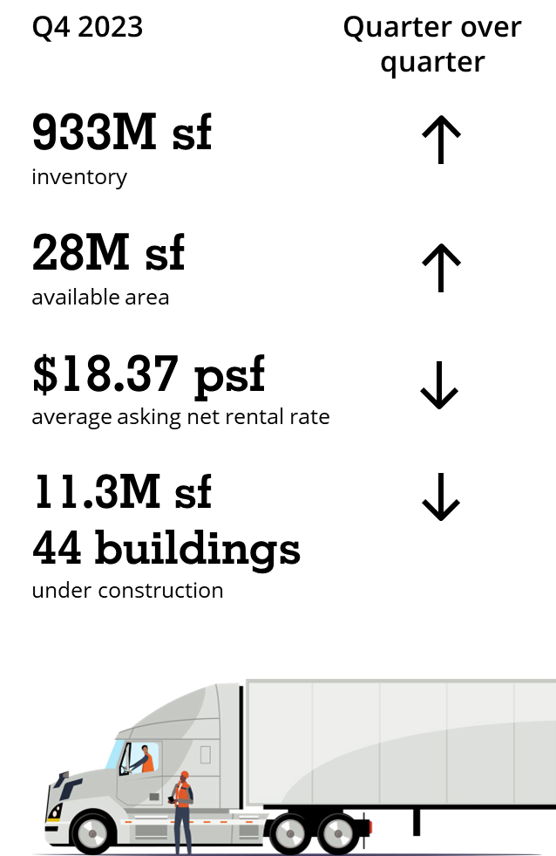
Industrial market trends
01
02 Rental rate growth has plateaued
Availability rises for the fourth consecutive quarter
The availability rose by 80 basis points (bps) in the fourth quarter to 3% (28 million sf). This is the highest rate since Q2 2017, when availability was 3.2%.
Average rental rates declined by $0.01 during the quarter to $18.37 psf. This marks the first time in 25 quarters that rental rate growth has stabilized.
Rates have risen by an average of 30% per year from 2018 to 2023, compared to a total of 4% between 2012 and 2017.
03
Record new supply arrives on market
39 buildings were completed during Q4 – bringing 8.8 million sf (33% leased) to the market. This is the highest volume of completions recorded in one quarter for more than a decade. Currently,
11.3 million sf is under construction (44 buildings).

Slide 5
Greater Toronto industrial market indicators
Average asking rents
Average net asking rents by clear height
Net asking rent ($psf)
Additional rent ($psf)
Average net asking rent ($psf)
$25
$22
$20
$18
$16
$14
$12
$10
$8
$6
$4
$2
$0
$18.98
$17.32
$17.74
$19.07
$17.80
$20
$15
$10
$5
$0
2013 Q4
2014 Q2
2014 Q4
2015 Q2
2015 Q4
2016 Q2
2016 Q4
2017 Q2
2017 Q4
2018 Q2
2018 Q4
2019 Q2
2019 Q4
2020 Q2
2020 Q4
2021 Q2
2021 Q4
2022 Q2
2022 Q4
2023 Q2
2023 Q4
Less than 18 feet
18 to 21 feet
22 to 25 feet
26 to 29 feet
30 feet and greater
Source: Altus Data Studio and Avison Young
Source: Altus Data Studio and Avison Young. 10,000 sf and greater available listings

Slide 6
VALUATION
Market
Comparable
Income
Approach
Replacement
Value
Review of sales or leases comparable to the subject property
Reflection of a steady market
Most common application
Used for income producing properties, or have the ability to be income producing
Use cap rate to determine
Rent and cap rate are moving variables directly reflecting risk based on asset class and geography
Cost to replace property
Construction costs, soft costs, land costs all used
Depreciation required for existing buildings
Replacement value used in reverse engineering to determine land prices

Slide 7
LAND PRICE
How to value land in fluctuating markets – back of the napkin math
Developer
Consumer Sale Price
Less: construction cost
Less: soft costs & development charges
Less: servicing, grading, carrying costs
Land Price
$500 per sq. ft.
$250 per sq. ft.
$75 per sq. ft.
$100 per sq. ft.
$75 per sq. ft. ($3,267,000.00 per acre)
Investor
Consumer Sale Price
Add: Tenant Improvement Costs
Add: Leasing Fees
Total Costs
Lease Rate @5% capitalization rate
$500 per sq. ft.
$25 per sq. ft.
$5 per sq. ft.
$530 per sq. ft.
$26.50 per sq. ft.

Slide 8
User Occupancy
Operating Costs
User Decision | Occupancy Costs
SALE
Consumer Sale Price (10,000 sq. ft.)
15% down
25 year amortization
5 year term
5% interest
Total term costs
Per sq. ft. cost per annum
$5,000,000
$750,000
$1,483,093 ($148.31 per sq. ft.)
$29.66 per sq. ft.
LEASE
Lease Rate (10,000 sq. ft.)
Total term costs
$26.50 per sq. ft.
$1,325,000.00

Slide 9
Thank you!

