Slide 1
Welcome to…
EDO’s = Jack of All Trades + Sustainability Experts?
EDCO 2024
February 7 11:30 – 12:30

Slide 2
Climate Action in Dufferin County
EDCO Conference
February 7, 2024
Sara MacRae
Manager of Climate & Energy

Slide 3
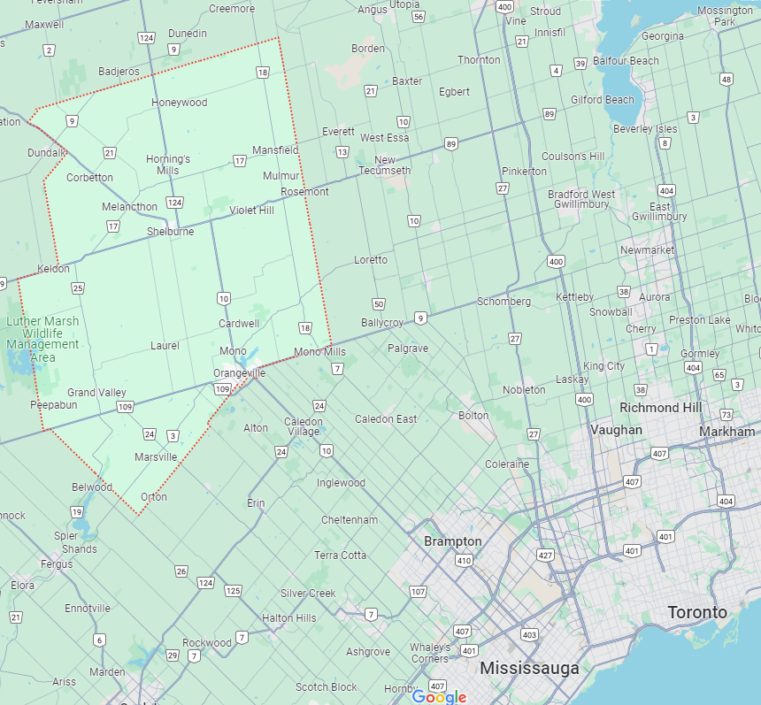
Dufferin County
Population 67,000
8 Local Municipalities
5 Conservation Authorities
3 Utilities
2 School Boards

Slide 4
Dufferin’s Climate Plans
Title Text
Notes:
Working group creating plans

Slide 5
Climate Priority: EV Acceleration
49%
GHGs
Title Text
Charge Up in Dufferin Network (2021)
Charging Ahead Fleet Electrification (2023)
Rural ReCharge: Regional EV Charging Network
Notes:
Transportation: 49% of emissions in Dufferin
Charge Up in Dufferin was the first EV infrastructure project for the County, where we partnered with 7 out of 8 of our member munis to ensure there was a spread of available EV charging infrastructure across the county with the goal of increased accessibility to reduce range anxiety
Charging Ahead project was just completed and was a partnership with

Slide 6
Climate Priority: Residential Sector
22%
GHGs
Title Text
BetterHomes Dufferin: Residential Retrofit Project
Tri-County Green Development Standard
Counties of Dufferin, Grey, and Wellington

Slide 7
Climate Priority:
Agriculture
16%
GHGs
Title Text
Rural Water Quality Program
Experimental Acres
07
Notes:
Rural Water Quality Program is administered through the Grand River Conservation Authority. We’re currently working on an update to the program to incorporate a climate lens to the initiatives covered in the program. Some

Slide 8
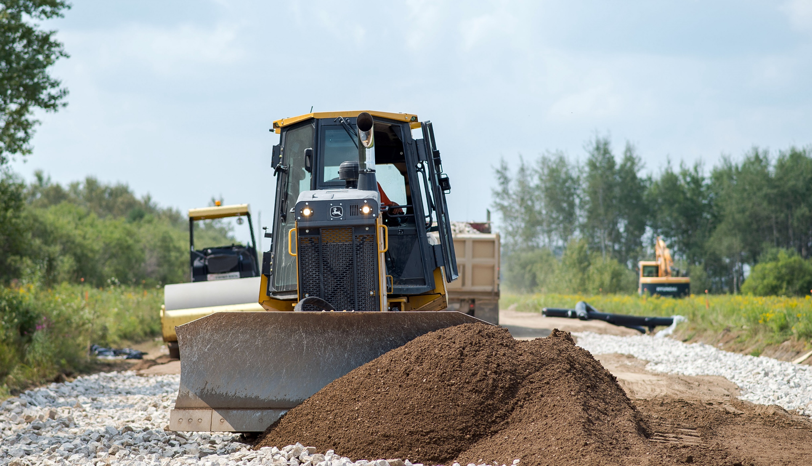
Climate Priority:
Community Resiliency
Climate Risk Assessment on County-owned infrastructure
Community Resilience Hubs
07
Notes:
2024…

Slide 9
Sara MacRae
Manager of Climate & Energy
Dufferin County
smacrae@dufferincounty.ca

Slide 10
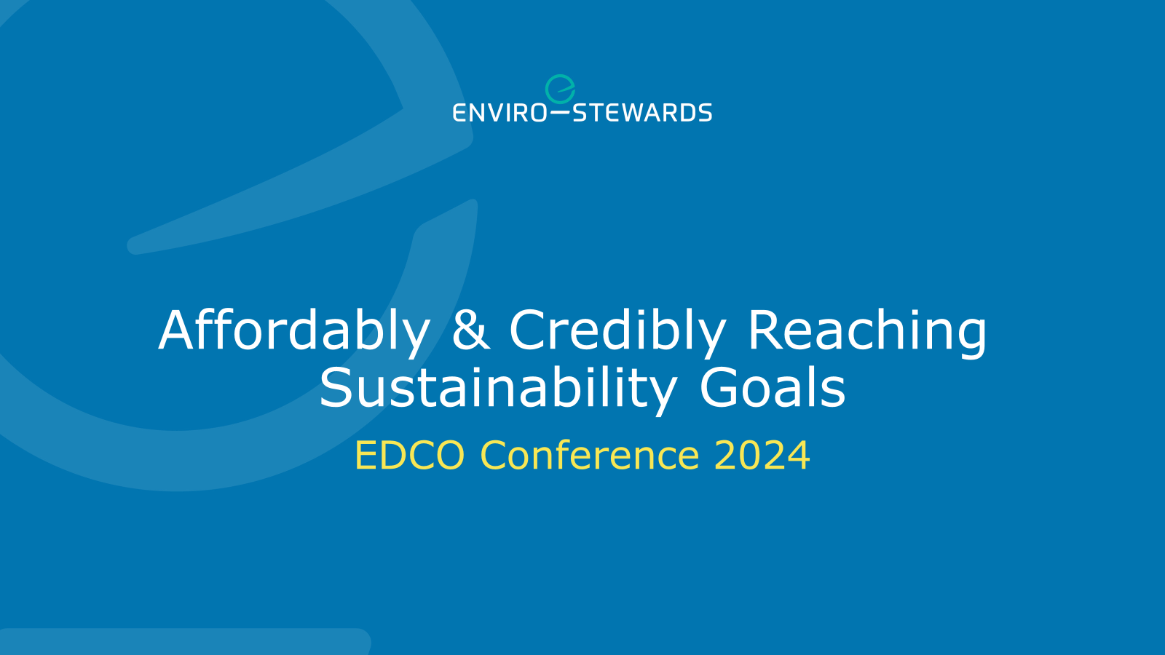

Slide 11
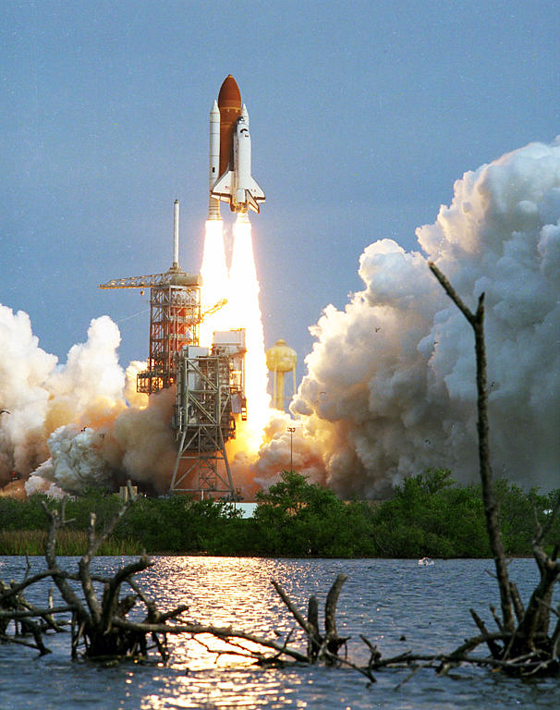
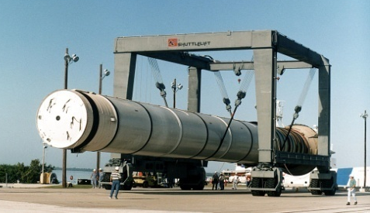
Agenda
Purpose:
Outline a proven profitable path to improve your environmental footprint
Process:
Introduction
Approach
Case Studies
Payoff:
Higher margins, smaller footprints, and Brand stewardship

Slide 12
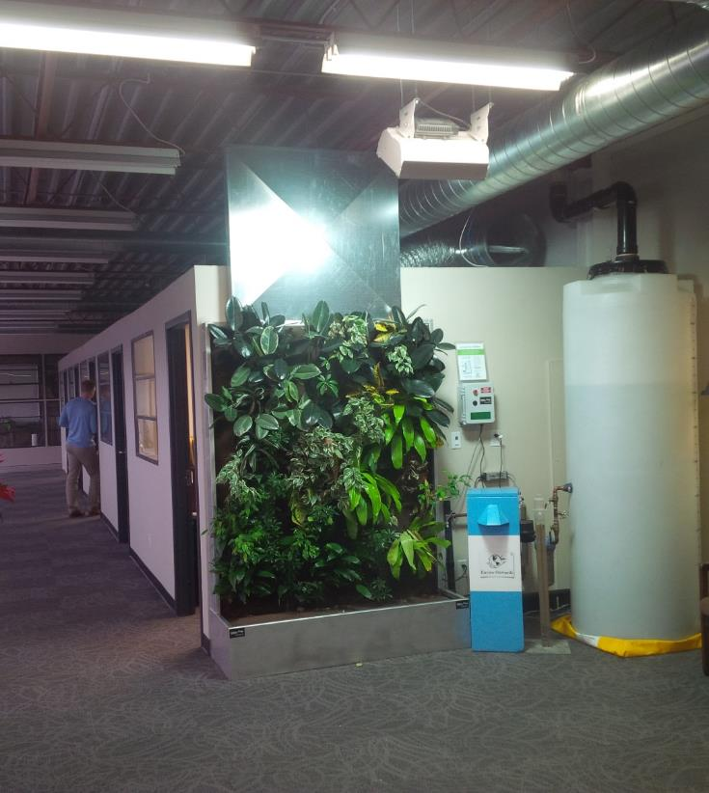
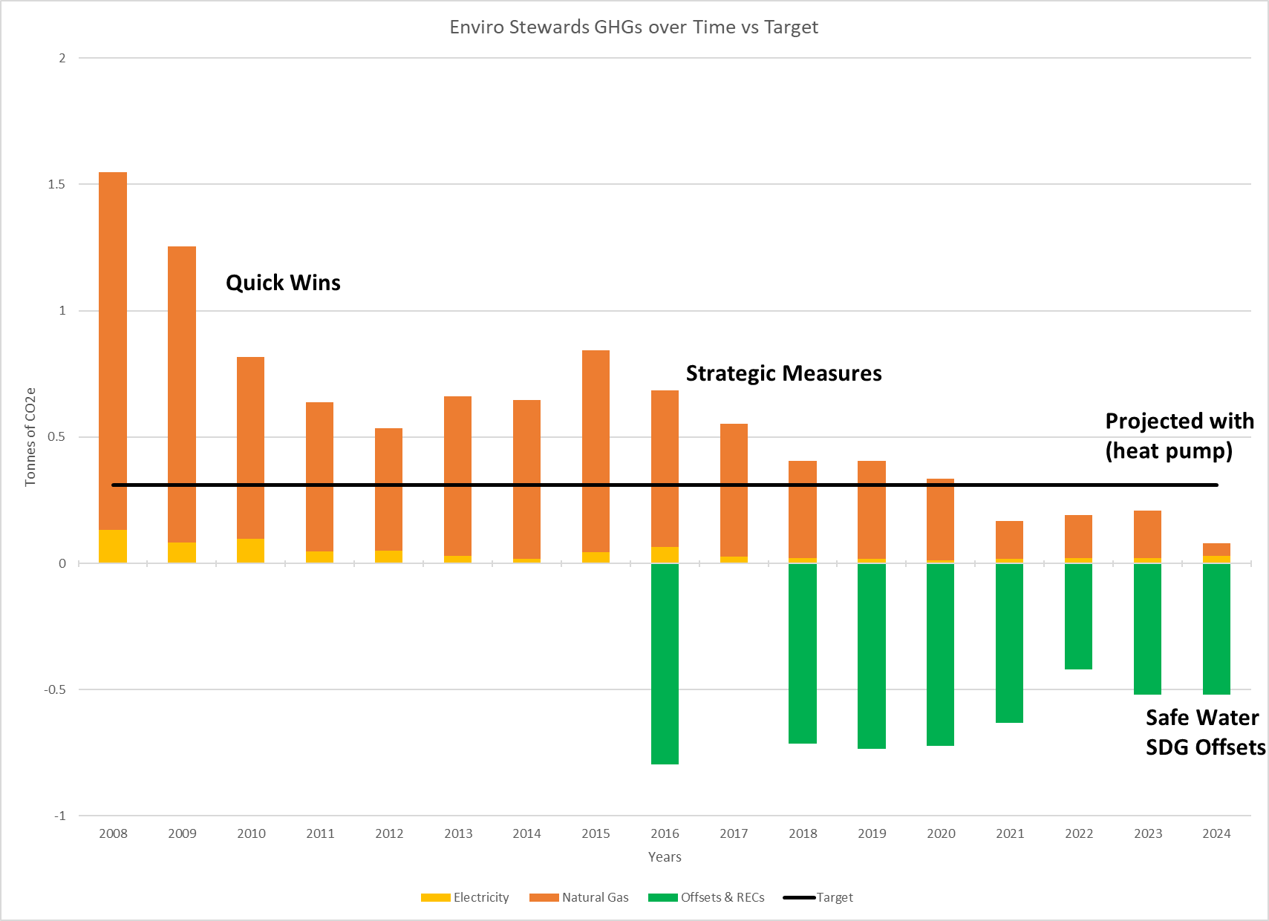
Case Study: Small facility (”Walk the Walk”)
Enviro-Stewards’ Footprint:
97% less outside air required
88% reduction in GHG/employee (95% in 2024)
0 L/yr tap water for living wall for 5 yrs
May 2021 added affordable smart blue roof
Enviro-Stewards’ Handprint:
+3.19 tonnes/yr of GHG remain
-119,858 tonnes/yr due to our work (avoiding 30,000 tonnes per tonne)
Property of Enviro-Stewards Inc.

Slide 13
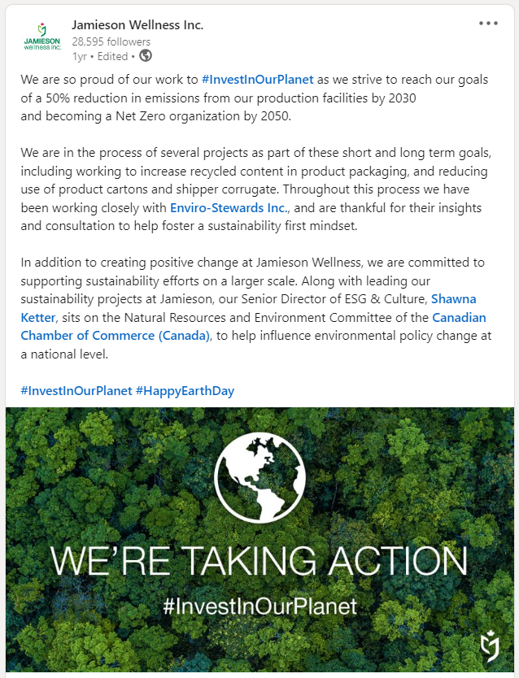
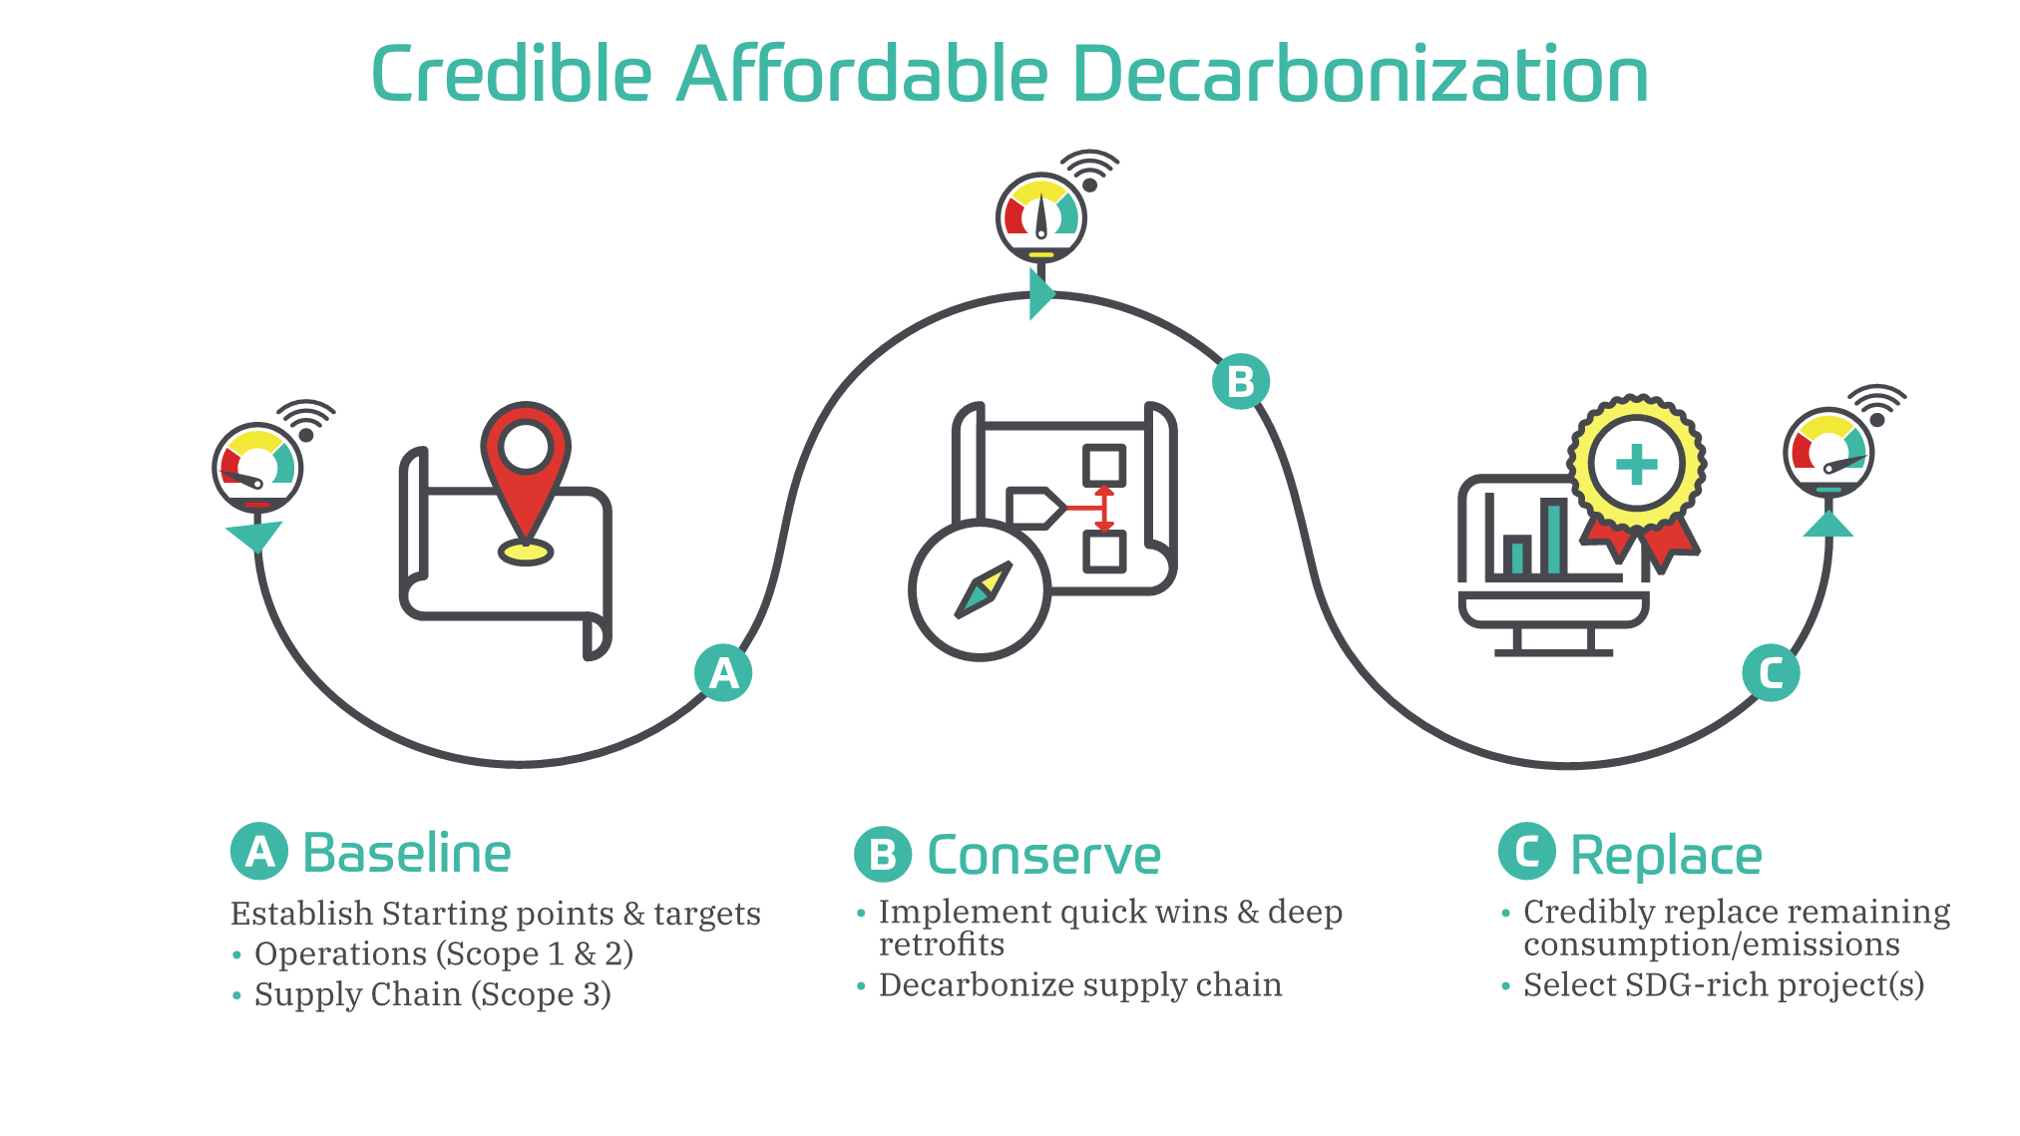
Decarbonization Roadmaps:
Enviro-Stewards (2018)
Maple Leaf Foods (2019)
Unilever Nutrition NA (2027)
Toyota Boshoku, Elmira (2050)
Jamieson Wellness (2050)
Property of Enviro-Stewards Inc.

Slide 14
Net zero/carbon neutral.
Building resilient businesses
Completed energy, water, and pollution prevention assessments at 35 facilities
MLF reports 572 of 1,300⁺ projects have been implemented (saving over $17 million to date)

Slide 15
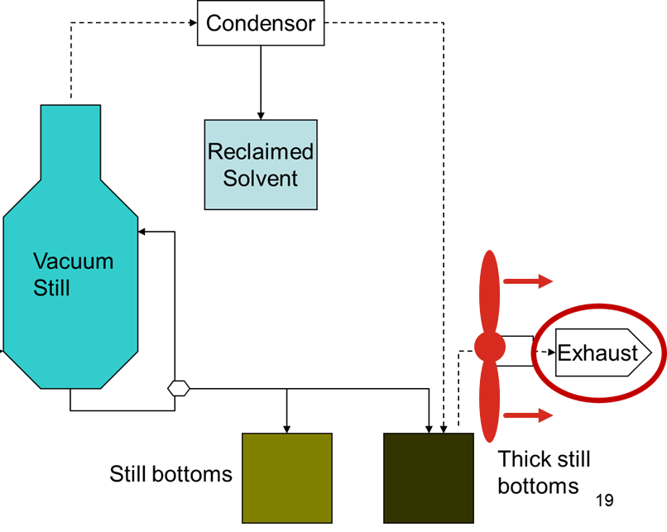
Integrated Approach: Conservation Measures
For Example:
if study electricity … new motor
If study thermal … heat exchanger
If study toxics … recover solvent, and
Save even more energy & money
Reduce worker exposure
Reduce toxic emissions
Reduce supply chain footprints
Property of Enviro-Stewards Inc.

Slide 16
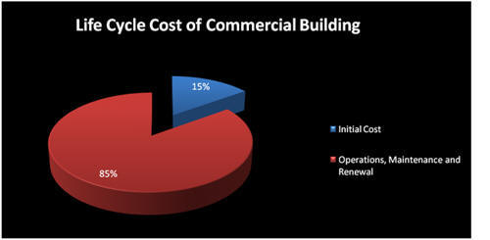
Life Cycle Costing
Design Build is simultaneously the cheapest and the most expensive way to build (depending on your time horizon)
Initial impulse is to minimize engineering (by building what has always been built)
and then minimize the capital cost to stay under a funding cap
This consistently maximizes the life cycle cost (and carbon footprint)!
Figure 1 – BOMA Life Cycle Graph (link)

Slide 17
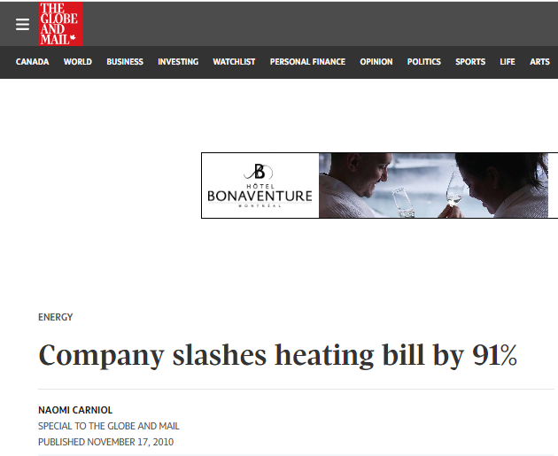
Case Study: Scope 4 (handprint)
Product Design for the Environment:
Their product initially used 200% of energy of competitor
Product redesigned to use 20% of energy of competitor
Veriform’s implemented measures have doubled their profit margin!
4.3%
9.4%
profit margin
profit margin

Slide 18
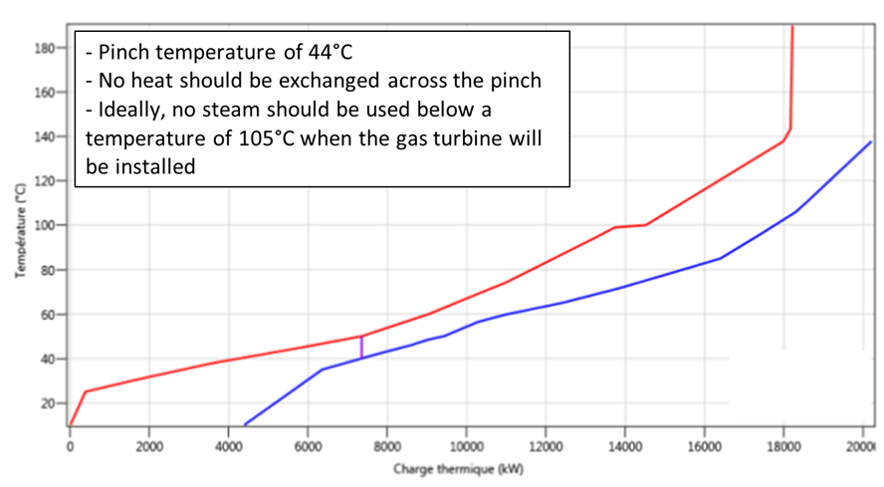
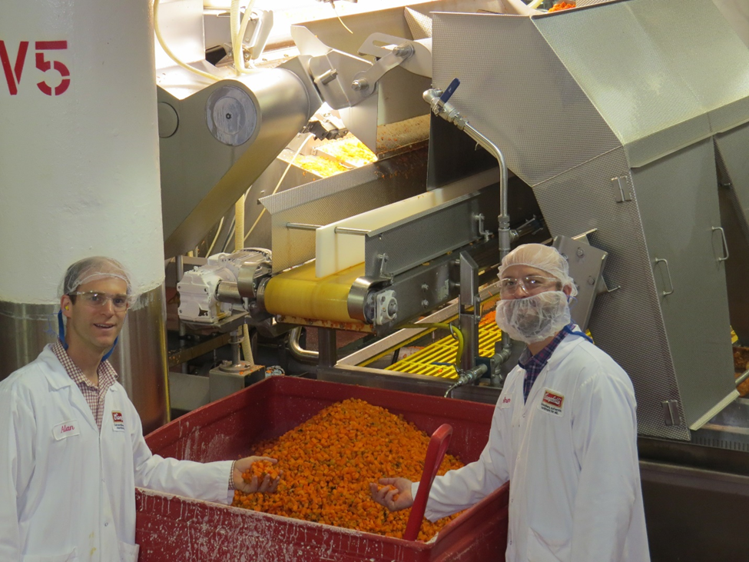
Integrated, Water, Energy & Product
Process Integration (PI) Study:
3,233,000 kWh/yr (14o tonnes)
4,570,000 m3/yr of gas (8,700 tonnes)
123,000 m3 of water (6 tonnes)
$1,645,000/yr with 2-year payback
Food Loss Prevention Study
$706,000/year food savings with 6-month payback (938 tonnes/yr)
4,000 tonnes/yr less (embedded) GHG!

Slide 19
Bruce Taylor, FCAE, P.Eng
btaylor@enviro-stewards.com
Christy Hipel
chipel@enviro-stewards.com

Slide 20
SUSTAINABILITY LEADERSHIP
Christopher Warren
Executive Director

Slide 21
A Bit About Me
Professional Experience:
Executive Director at Sustainability – 2023
Director, Government and Community Relations at Brock University
Ontario Ministry of Energy, Office of the Minister
Ontario Ministry of Colleges and Universities, Office of the Minister
Ontario Ministry of Infrastructure, Office of the Parliamentary Assistant to the Minister
Education:
B.A. (Honours) in History and Political Science
Board Experience:
Travel Industry Council of Ontario
Future Energy Oakville
Oakville Soccer Club
Toronto Rugby Union
Crusaders Rugby Club

Slide 22
Our Mission.
Founded in 2011, we inspire and empower sustainability leadership in local businesses to help them realise the economic benefits of sustainable practises and create measurable, community-wide progress to greater sustainability.
Transformed from a local-based organization named Sustainability Hamilton to a globally-focused one called Sustainability Leadership.

Slide 23
Our Actions
Thought-Leadership Events
Sustainability Innovation Hackathon
Sustainability Business Expo
Sustainability Leadership Awards
Sustainability Tools & Resources
White Papers
Microcredentials in Partnership with eCampus Ontario
Webinars and Seminars
Mentorship & Leadership
Volunteer Opportunities
Business Consulting
Specific Membership Services to 15 Members

Slide 24
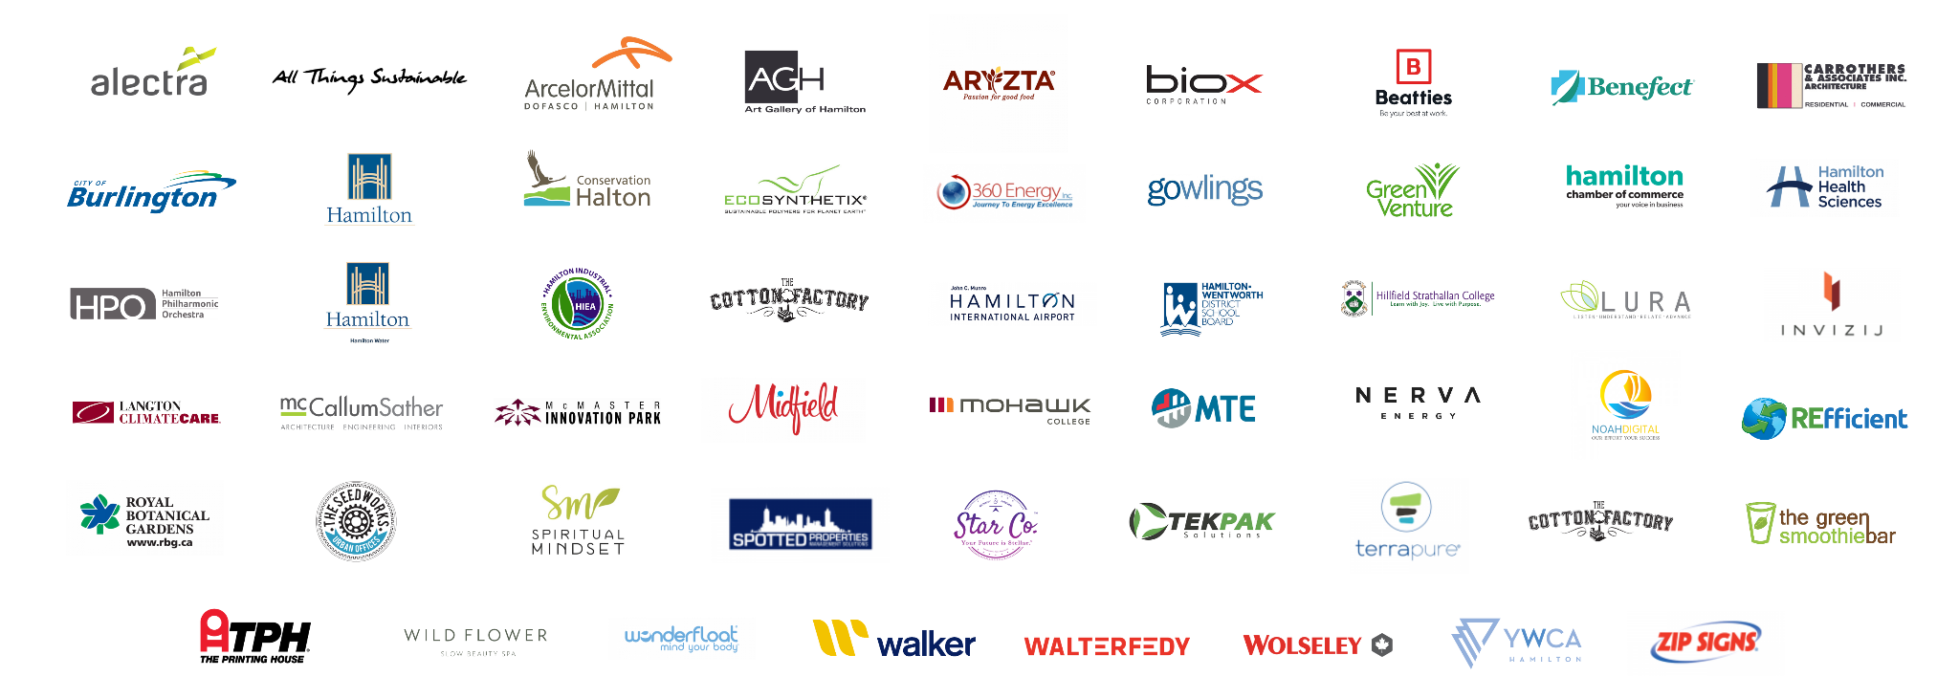
Our work has supported over
50 local businesses.
We have helped to reduce over 156,000 tons of GHGs and implement
over 200 local projects over the past few years.

Slide 25
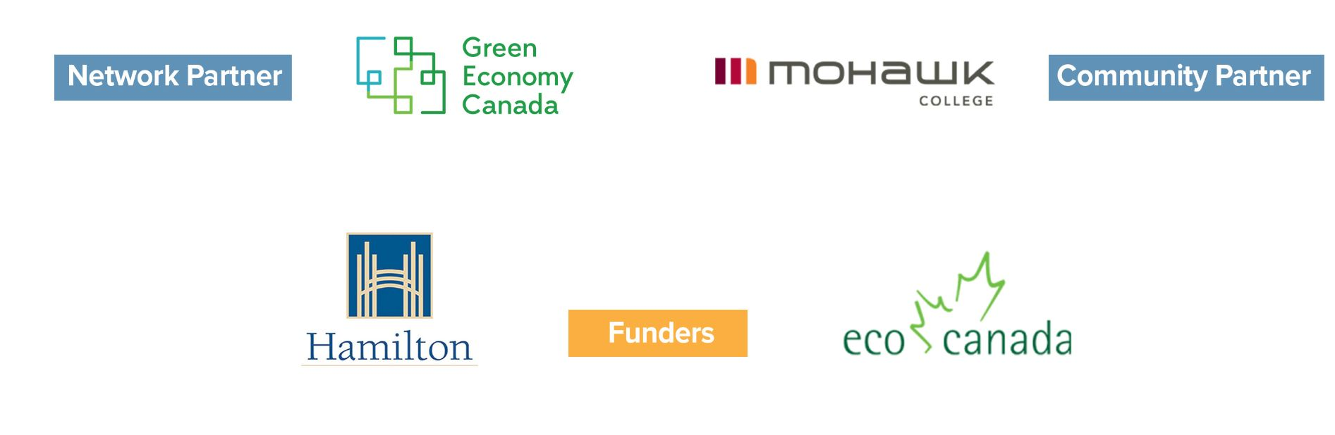
Thank you to our Partners & Funders.

Slide 26
Looking for more?
Follow us on social media.

Slide 27
Panel Q and A

Slide 28
Thank You Panelists
Sara MacRae
Manager of Energy and Climate, Dufferin County
saramacrae@dufferincounty.ca
Bruce Taylor
Enviro-Stewards
btaylor@enviro-stewards.com
Christopher Warren
Executive Director, Sustainability Leadership
christopher.warren@sustainabilityleadership.ca

