Slide 1
Pay Equity 101 – any audience-specific changes must be pre-approved by director before using
How Gender Wage Gap in Ontario Varies by Municipality
EDCO Conference, February 7, 2024

Slide 2
CONTRIBUTING FACTORS
Municipalities with higher levels of women with post-secondary education seem to be more likely to have a smaller gender wage gap.
Jurisdictions with a greater number of female-dominated industries tend to have smaller wage gaps (and vice versa).
Jurisdictions where the average maternal age at first birth is lower tend to have wider gender wage gaps

Slide 4
GENDER WAGE GAP IN ONTARIO MUNICIPALITIES
Out of approx. 50 reviewed municipalities in Ontario, the largest gender wage gap is observed in:
Petawawa, 47%
Timmins, 38%
Centre Wellington, 37%
While the smallest gender wage gap is seen in:
Elliot Lake, 8%
Leamington, 14%
Sault Ste. Marie, 15%
(Ontario and Canada: 13%)

Slide 5
ELLIOT LAKE

Slide 6
LEAMINGTON

Slide 7
PETAWAWA

Slide 8
CONTRIBUTING FACTORS
Labour Market Participation rates.
Increased time spent on unpaid domestic work.
Little access to essential services like childcare and public transporation.

Slide 9
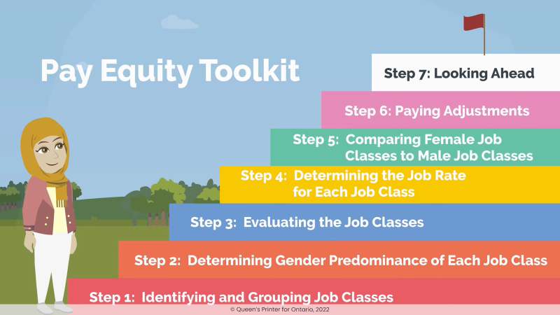
PEO TOOLS AND RESOURCES
LevelThePayingField.ca

Slide 10
Thank You
www.payequity.gov.on.ca
Twitter: @OntPayEquity
LinkedIn: Ontario Pay Equity Office

