Slide 1
EDO’s = Jack of all Trades + Sustainability Experts?
EDCO Conference 2024
ConnectiON Building Ontario Together!

Slide 2
Climate Action in Dufferin County
EDCO Conference
February 7, 2024
Sara MacRae
Manager of Climate & Energy

Slide 3
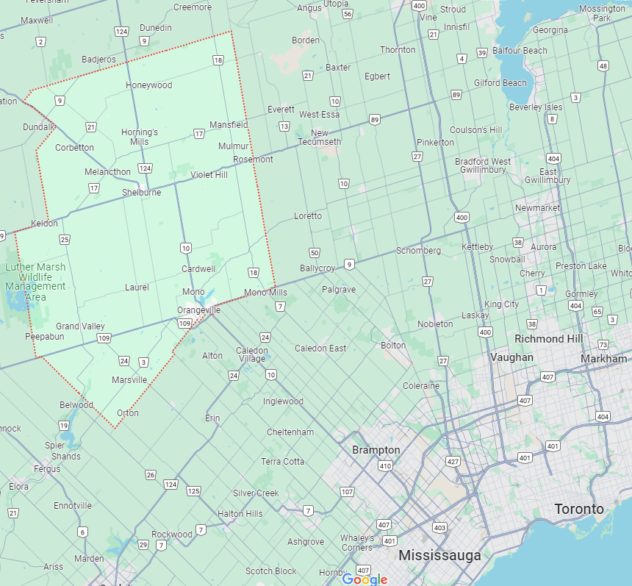
Dufferin County
Population 67,000
8 Local Municipalities
5 Conservation Authorities
3 Utilities
2 School Boards

Slide 4
Dufferin’s Climate Plans
Title Text
Notes:
Working group creating plans

Slide 5
Climate Priority: EV Acceleration
49%
GHGs
Title Text
Charge Up in Dufferin Network (2021)
Charging Ahead Fleet Electrification (2023)
Rural ReCharge: Regional EV Charging Network
Notes:
Transportation: 49% of emissions in Dufferin
Charge Up in Dufferin was the first EV infrastructure project for the County, where we partnered with 7 out of 8 of our member munis to ensure there was a spread of available EV charging infrastructure across the county with the goal of increased accessibility to reduce range anxiety
Charging Ahead project was just completed and was a partnership with

Slide 6
Climate Priority: Residential Sector
22%
GHGs
BetterHomes Dufferin: Residential Retrofit Project
Tri-County Green Development Standard
Counties of Dufferin, Grey, and Wellington

Slide 7
Climate Priority:
Agriculture
16%
GHGs
Rural Water Quality Program
Experimental Acres
07
Notes:
Rural Water Quality Program is administered through the Grand River Conservation Authority. We’re currently working on an update to the program to incorporate a climate lens to the initiatives covered in the program. Some

Slide 8
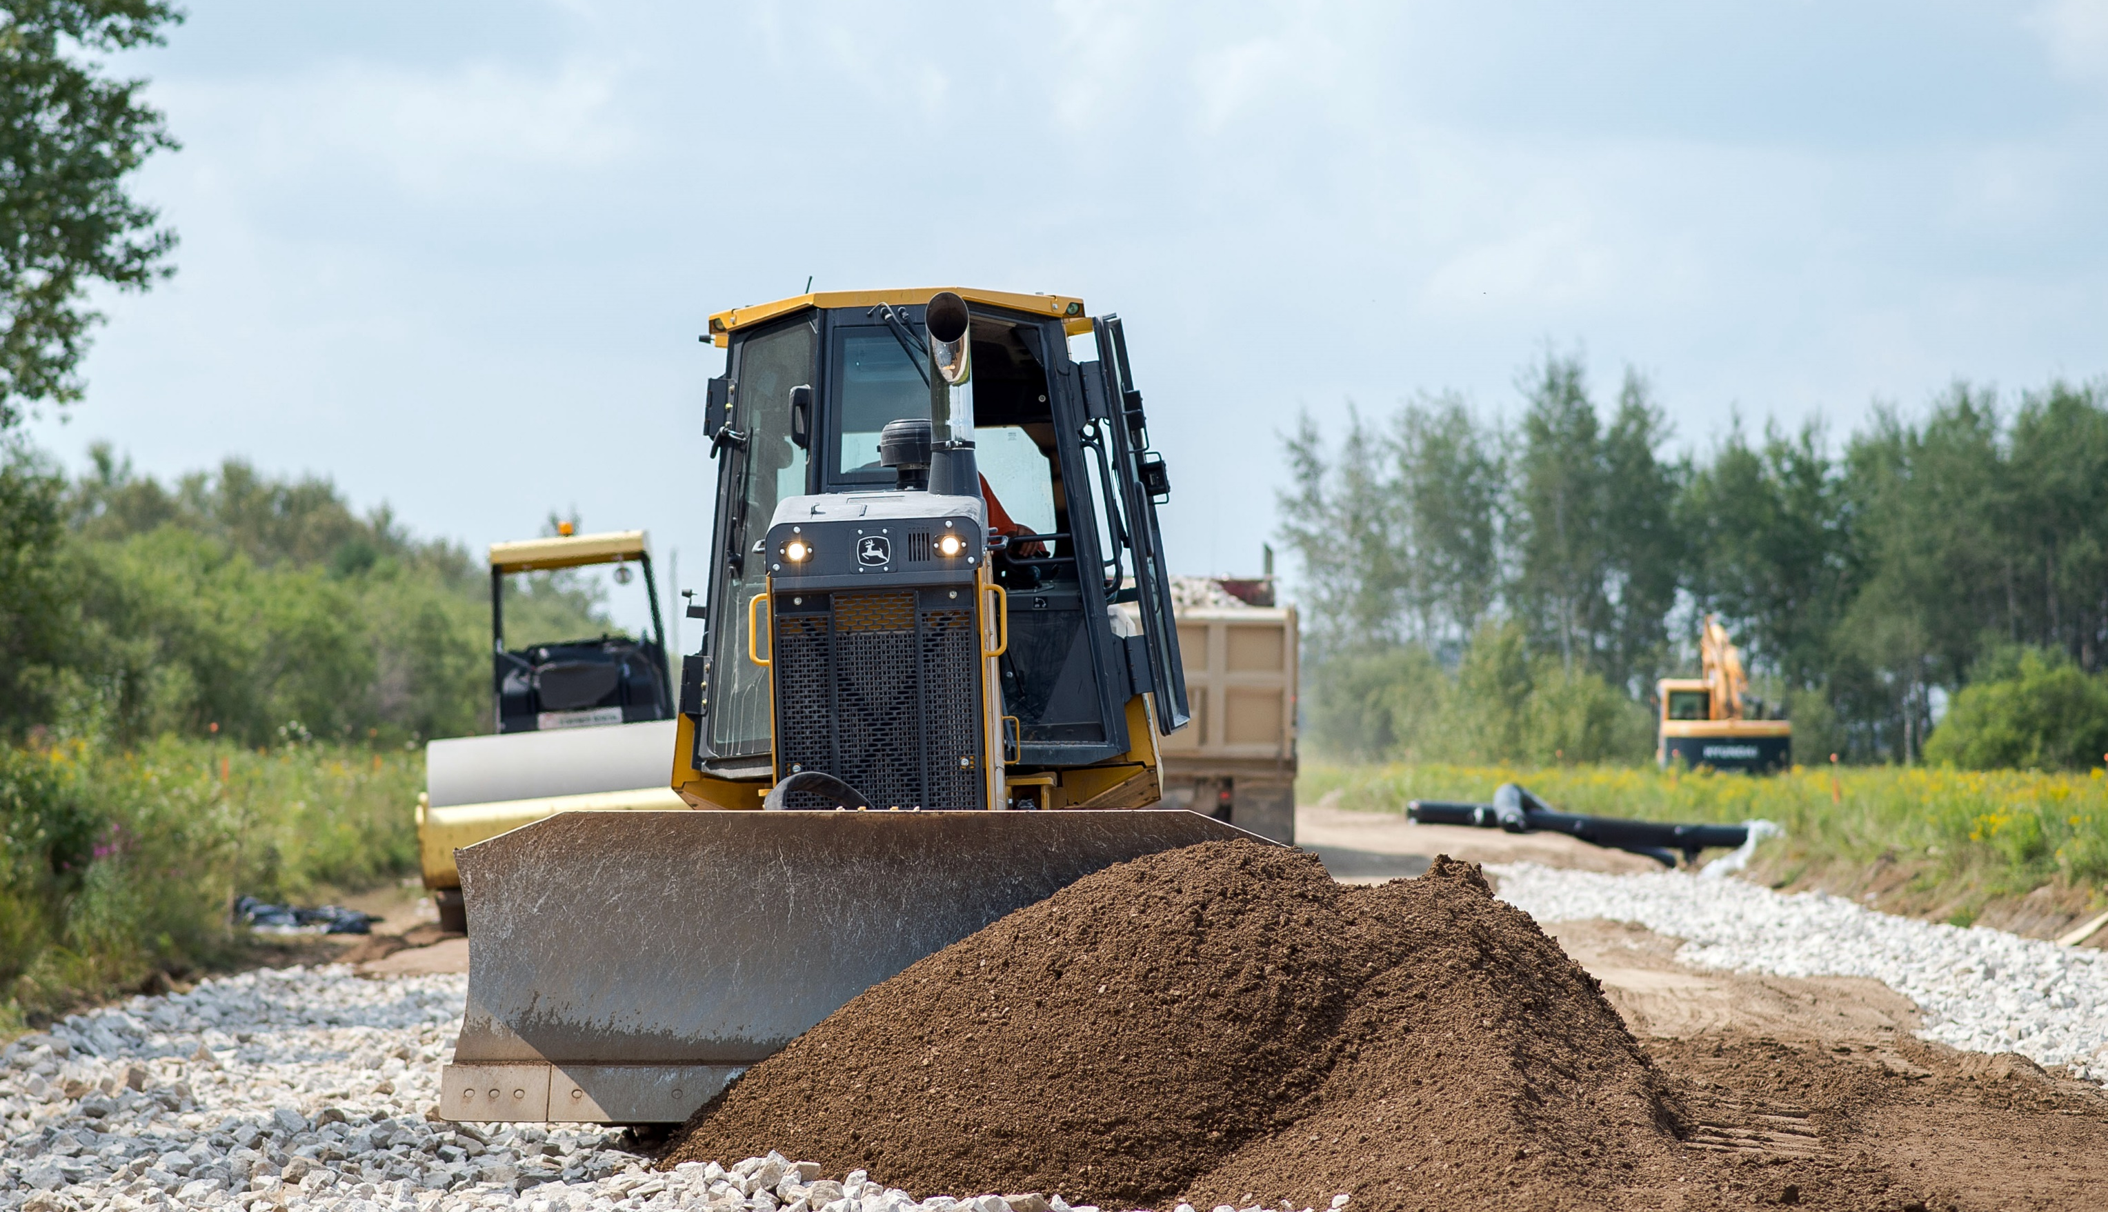
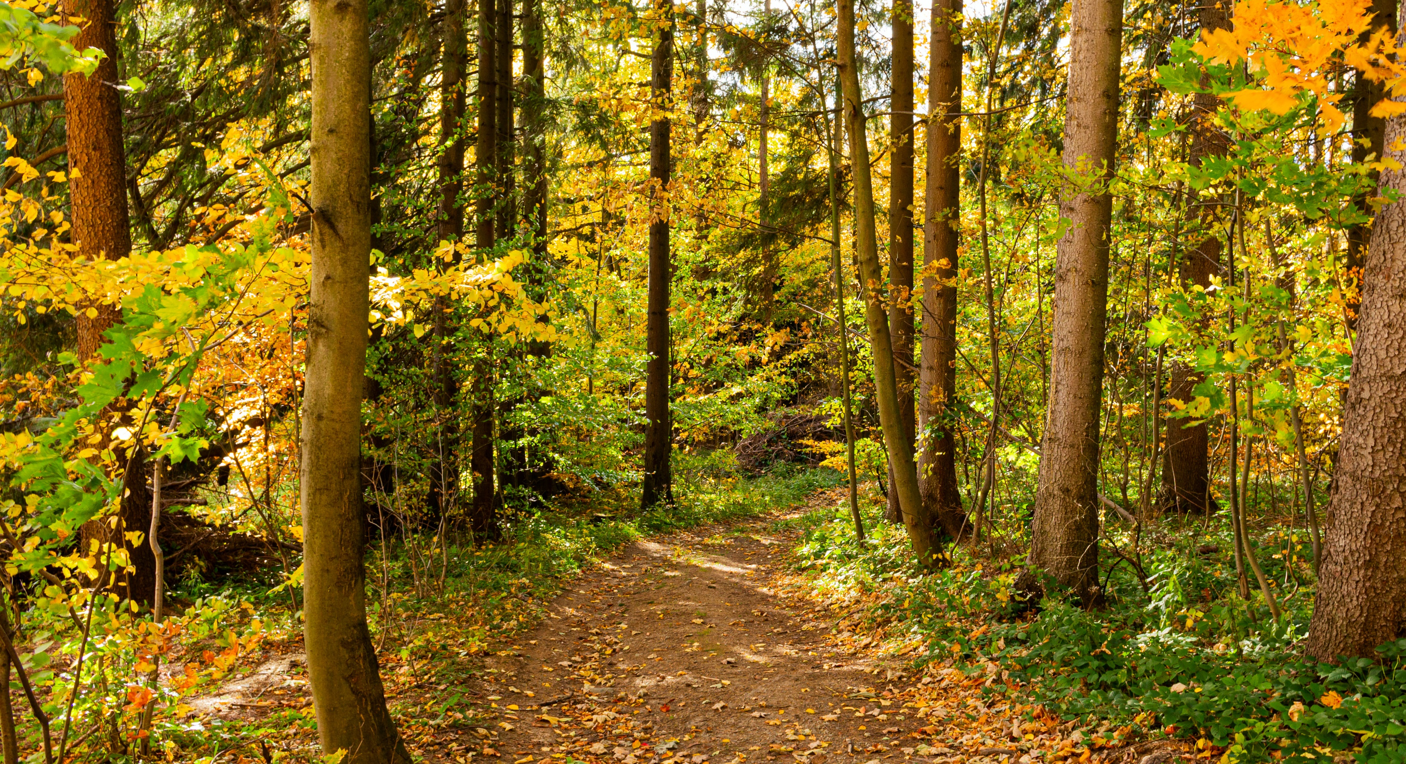
Climate Priority:
Community Resiliency
Climate Risk Assessment on County-owned infrastructure
Community Resilience Hubs
07
Notes:
2024…

Slide 9
Sara MacRae
Manager of Climate & Energy
Dufferin County
smacrae@dufferincounty.ca

Slide 10
Affordably & Credibly Reaching Sustainability Goals
EDCO Conference 2024

Slide 11
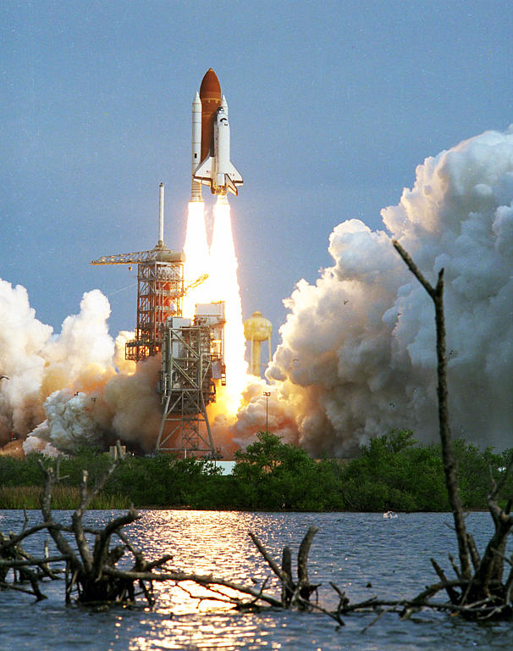
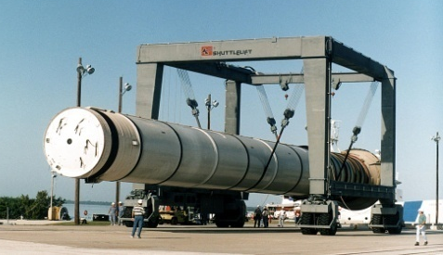
Agenda
Purpose:
Outline a proven profitable path to improve your environmental footprint
Process:
Introduction
Approach
Case Studies
Payoff:
Higher margins, smaller footprints, and Brand stewardship

Slide 12
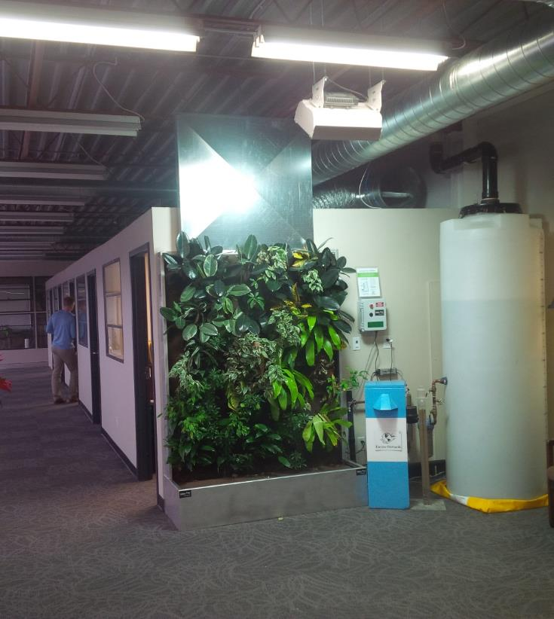
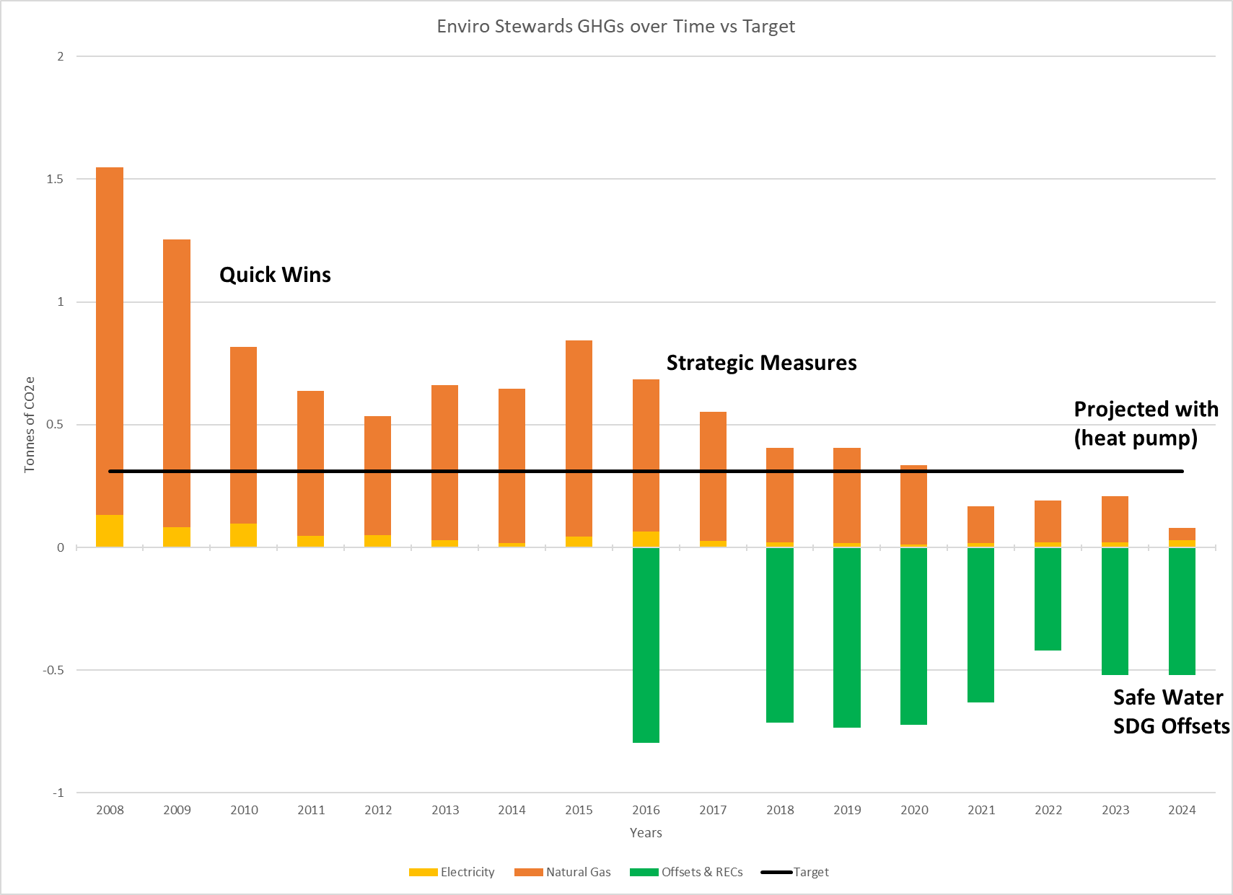
Case Study: Small facility (”Walk the Walk”)
Enviro-Stewards’ Footprint:
97% less outside air required
88% reduction in GHG/employee (95% in 2024)
0 L/yr tap water for living wall for 5 yrs
May 2021 added affordable smart blue roof
Enviro-Stewards’ Handprint:
+3.19 tonnes/yr of GHG remain
-119,858 tonnes/yr due to our work (avoiding 30,000 tonnes per tonne)
Property of Enviro-Stewards Inc.

Slide 13
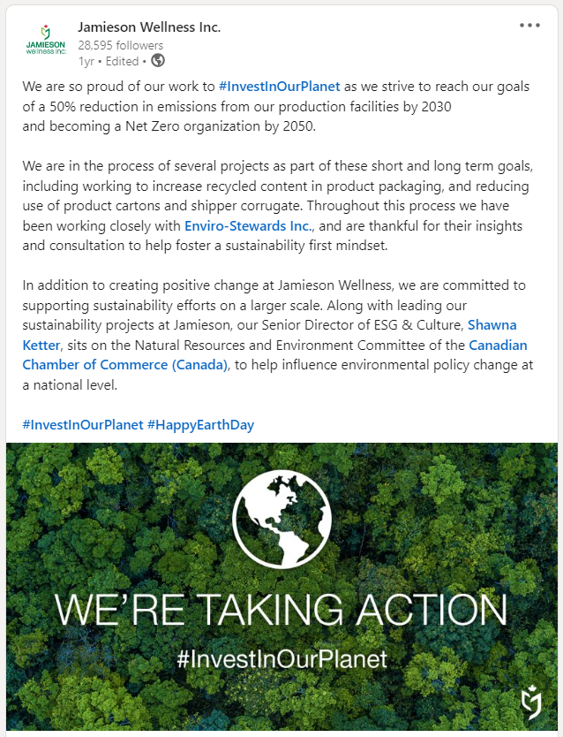
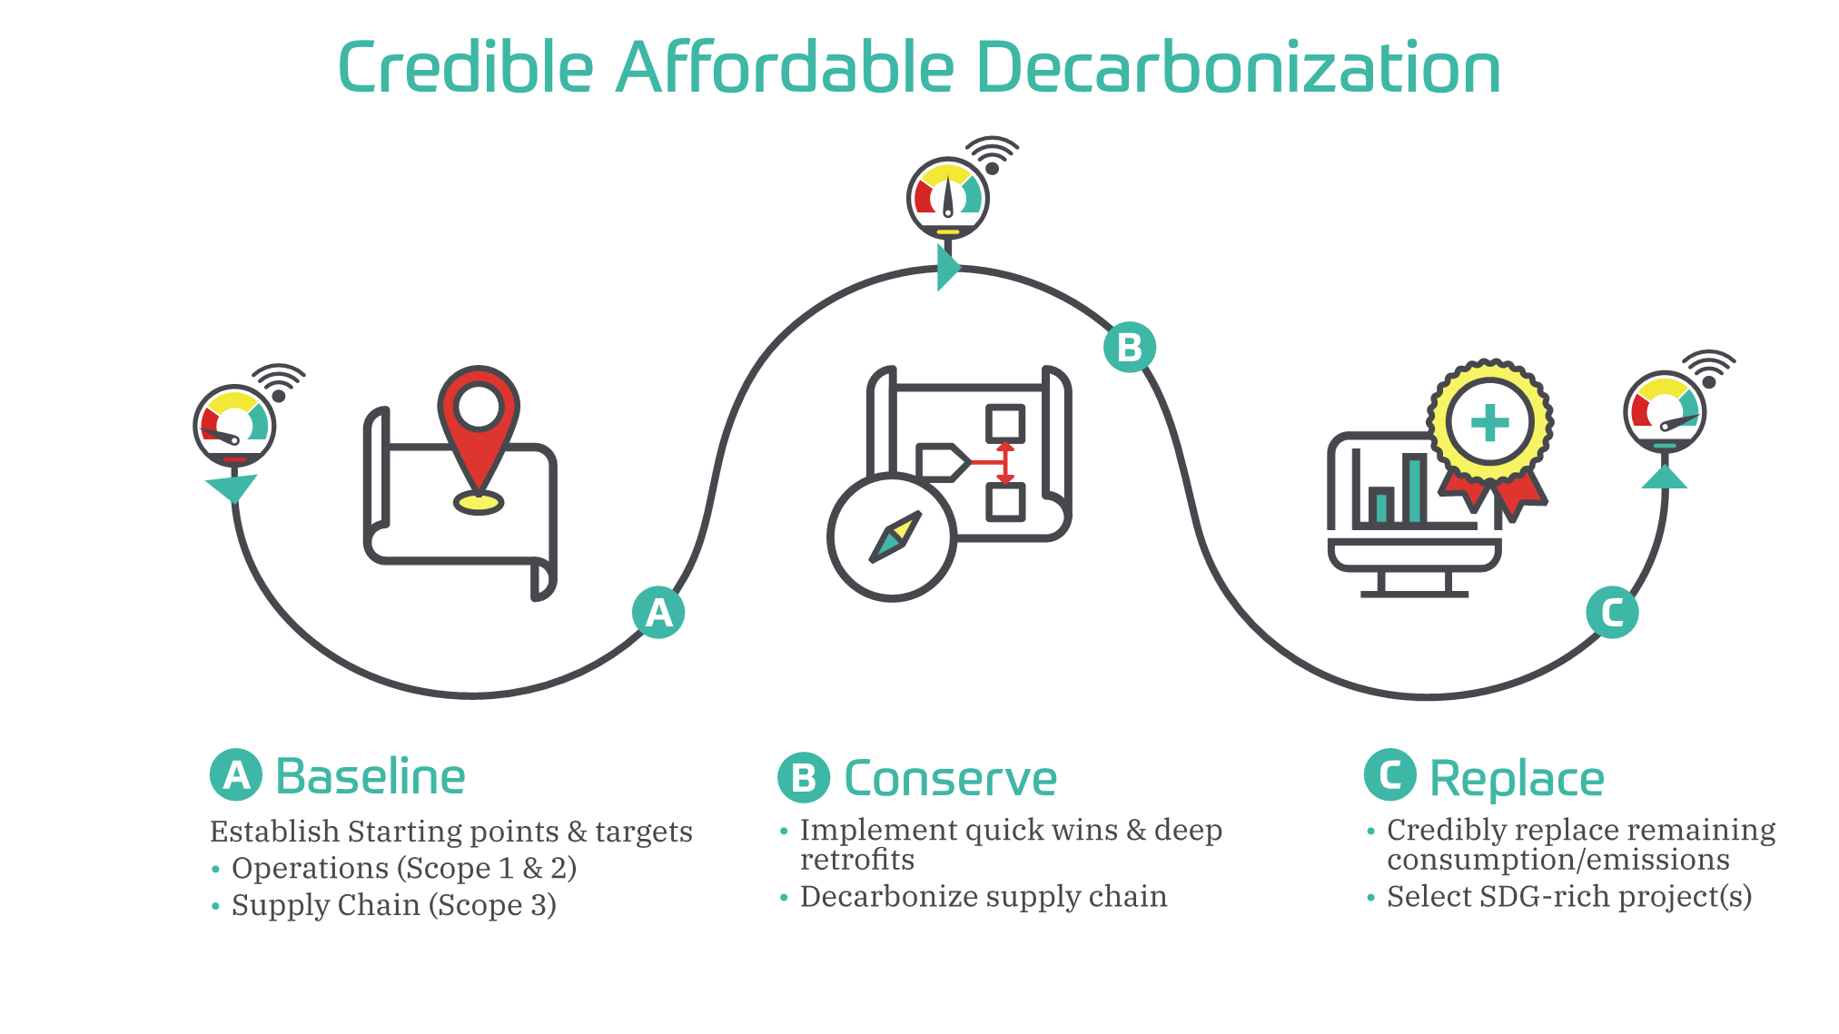
Decarbonization Roadmaps:
Enviro-Stewards (2018)
Maple Leaf Foods (2019)
Unilever Nutrition NA (2027)
Toyota Boshoku, Elmira (2050)
Jamieson Wellness (2050)
Property of Enviro-Stewards Inc.

Slide 14
Net zero/carbon neutral.
Building resilient businesses
Completed energy, water, and pollution prevention assessments at 35 facilities
MLF reports 572 of 1,300⁺ projects have been implemented (saving over $17 million to date)

Slide 15
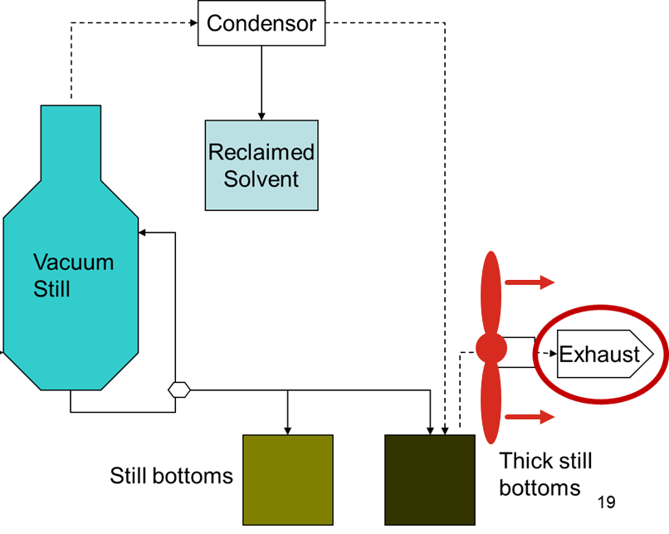
Integrated Approach: Conservation Measures
For Example:
if study electricity … new motor
If study thermal … heat exchanger
If study toxics … recover solvent, and
Save even more energy & money
Reduce worker exposure
Reduce toxic emissions
Reduce supply chain footprints
Property of Enviro-Stewards Inc.

Slide 16
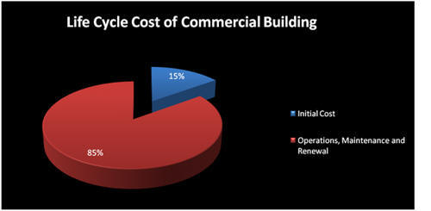
Life Cycle Costing
Design Build is simultaneously the cheapest and the most expensive way to build (depending on your time horizon)
Initial impulse is to minimize engineering (by building what has always been built)
and then minimize the capital cost to stay under a funding cap
This consistently maximizes the life cycle cost (and carbon footprint)!
Figure 1 – BOMA Life Cycle Graph (link)

Slide 17
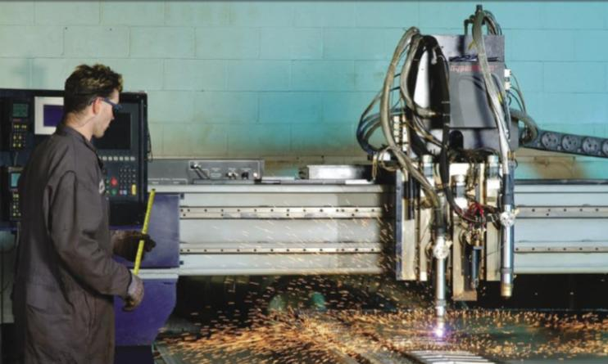
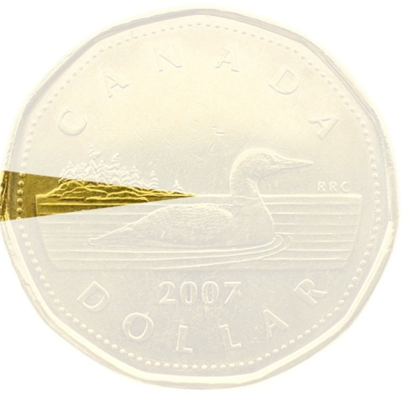
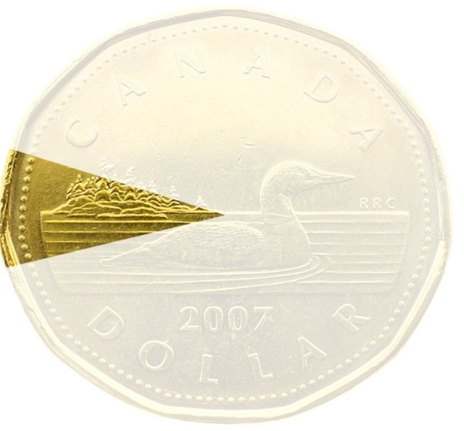
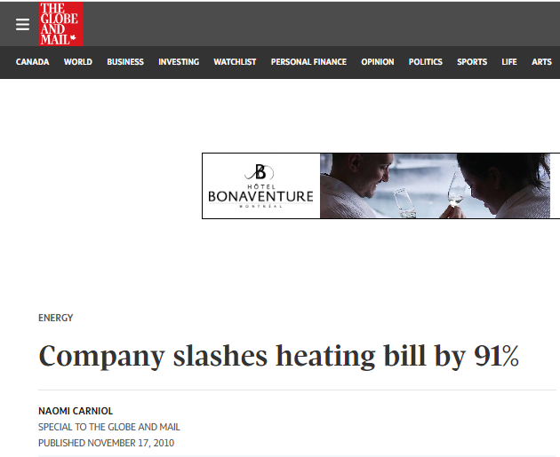
Case Study: Scope 4 (handprint)
Product Design for the Environment:
Their product initially used 200% of energy of competitor
Product redesigned to use 20% of energy of competitor
Veriform’s implemented measures have doubled their profit margin!
4.3%
9.4%
profit margin
profit margin

Slide 18
Case Study: Scope 4 (handprint)
Product Design for the Environment:
Their product initially used 200% of energy of competitor
Product redesigned to use 20% of energy of competitor
Veriform’s implemented measures have doubled their profit margin!
4.3%
9.4%
profit margin
profit margin

Slide 19
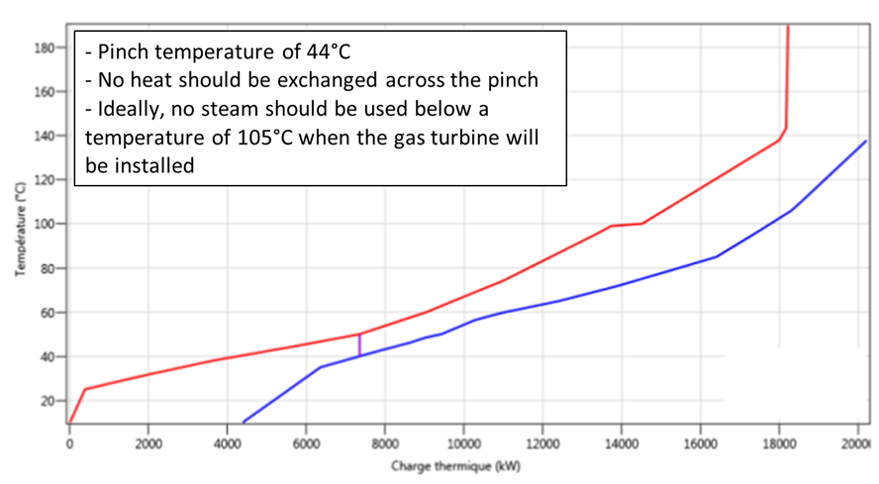
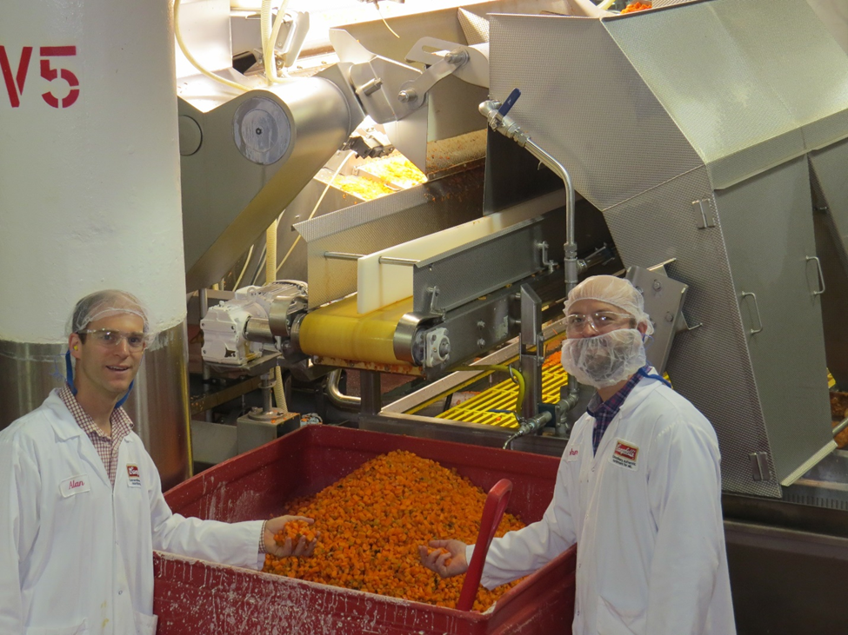
Integrated, Water, Energy & Product
Process Integration (PI) Study:
3,233,000 kWh/yr (14o tonnes)
4,570,000 m3/yr of gas (8,700 tonnes)
123,000 m3 of water (6 tonnes)
$1,645,000/yr with 2-year payback
Food Loss Prevention Study
$706,000/year food savings with 6-month payback (938 tonnes/yr)
4,000 tonnes/yr less (embedded) GHG!

Slide 20
Bruce Taylor, FCAE, P.Eng
btaylor@enviro-stewards.com
Christy Hipel
chipel@enviro-stewards.com

Slide 21
Green Skills in Manufacturing Modules
GSC-1: Introduction to Sustainable Manufacturing
GSC-2: Charting a Path to Net Zero
GSC-3: Water Conservation
GSC-4: Energy Conservation
GSC-5: Reducing and Upcycling Waste
GSC-6: Implementing Change
GSC-7: The Power of Purpose
GSC-8: Going Green: WPP Results and Presentation, Certification
Notes:
Hi Everyone, and welcome to the third module: water conservation. This is the third module of eight modules, with the last module being the presentations of the WPP.

