Slide 1
Enabling Growth in Ontario’s Energy Transition
February 7, 2024
Denise Jamal, Director, Stakeholder and Community Engagement
Ahmed Maria, Director, Transmission Planning

Slide 2
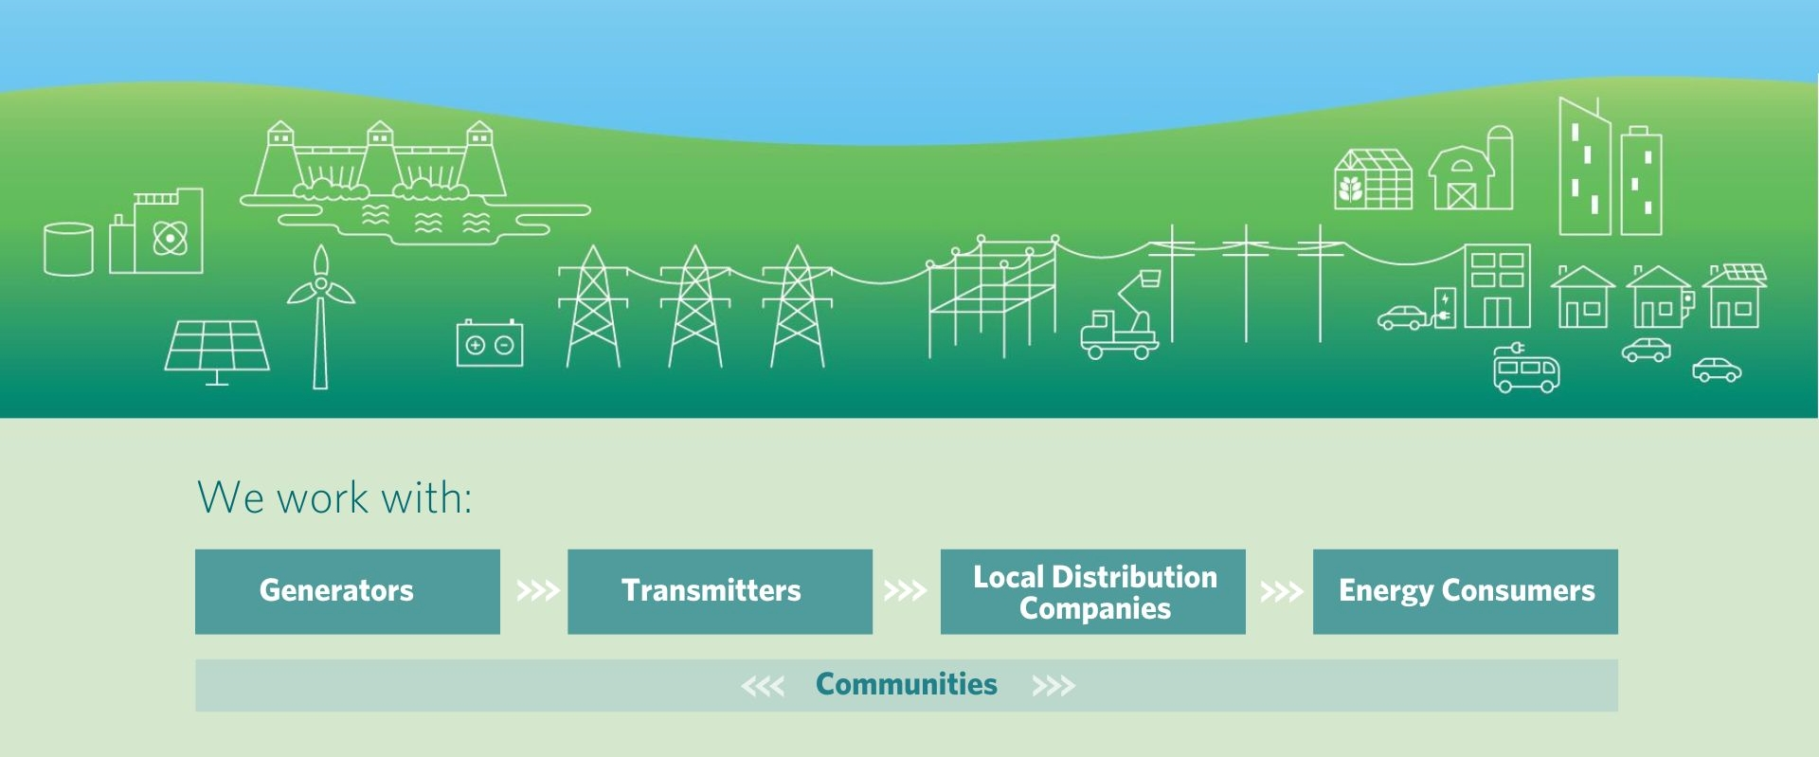
Ontario’s Electricity Sector

Slide 3
The Role of the IESO
To keep the lights on today, and into the future, the IESO:
Forecasts Ontario’s energy needs on a real-time basis and at the regional and provincial level
Plans Ontario's high-voltage transmission lines that transport electricity from suppliers to Ontario's communities, including through the Annual Planning Outlook, regional planning and many others
Secures new and existing facilities to meet system needs in the short, medium and long term in a timely, cost-effective and flexible way
Delivers key programs and initiatives to address needs at the regional and provincial level

Slide 4
Ontario’s Changing Electricity Landscape
This is a pivotal point for the electricity system. Ontario is entering a period of growing needs – by 2050, energy consumption could double
These needs are being driven by economic growth, population growth and increased electrification
This demand growth is happening in the midst of expiring generator contracts, nuclear refurbishments and the elimination of emissions from the grid
To meet the emerging needs, Ontario will require additional new electricity infrastructure, including new supply and transmission

Slide 5
Securing our Electricity Future
What We’ve Done | What We’re Doing
Expanded existing conservation and demand side management programs Signed memorandum of understanding for capacity swap with Hydro Quebec Planned transmission expansions in many areas of the province, including in the north and south to address urgent needs Procured largest fleet of battery storage in Canada, combined with efficiency upgrades and expansions at existing gas generation facilities Launched the Hydrogen Innovation Fund | Developing the next generation of energy efficiency programs Developing a competitive framework for selecting transmitters Planning for new nuclear generation Procuring non-emitting supply Integrating local generation Planning more transmission expansions

Slide 6
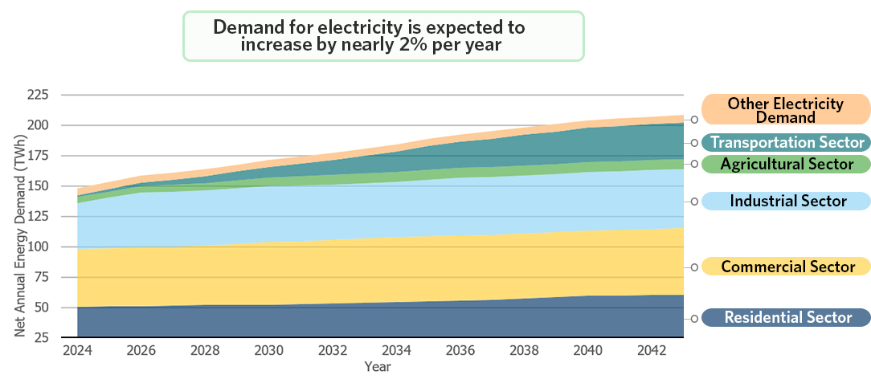
20-Year Provincial Outlook

Slide 7
Electricity Planning in Ontario
Bulk system planning
Regional planning & Community Engagement
Distribution network planning
Addresses provincial electricity system needs and policy directions
Integrates local and provincial electricity needs at a regional level, ensuring sufficient supply to local distribution companies (LDCs) and large customers in the region
Examines local electricity system needs and priorities at community/neighbourhood level by LDCs

Slide 8
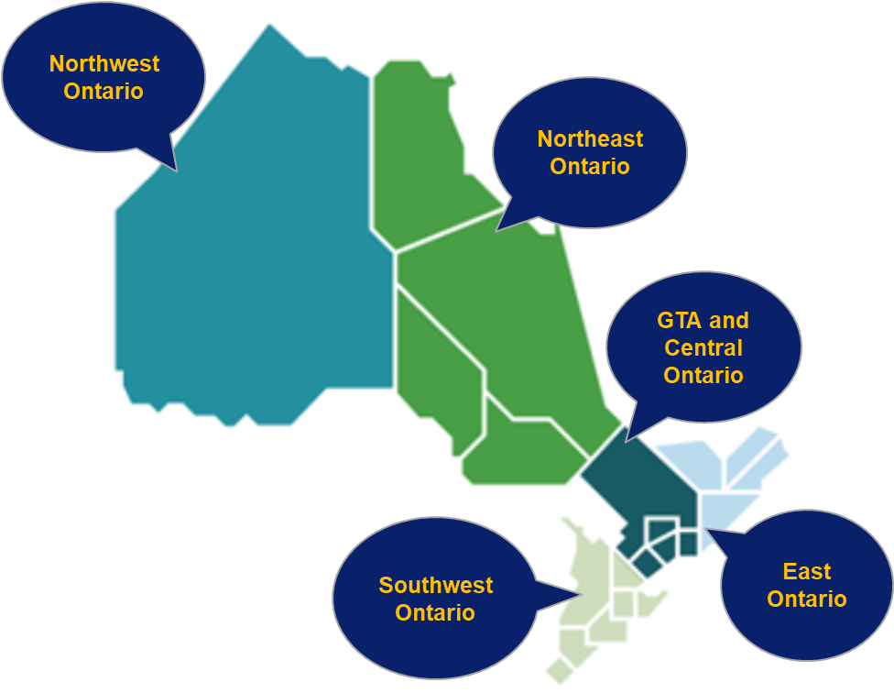
Communities have a Critical Role in Regional Electricity Planning
Participating in the Regional Electricity Planning process is critical to maintain reliable and adequate supply of electricity
Communities provide input on the following components within the plan:
Help to identify future electricity needs
Seek input on a variety of options to meet needs
Provide feedback on plan recommendations
Learn more at www.ieso.ca/regional-planning

Slide 9
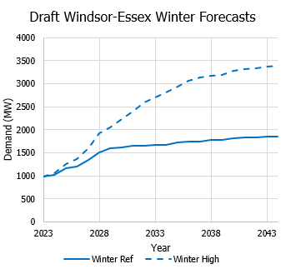
Case Study: Southwest Ontario
Electricity demand is quadrupling in southwest Ontario due to agriculture growth and new battery production facilities.
The IESO has engaged with municipalities, greenhouses, First Nations and other local stakeholders.
A multi-pronged approach is being implemented, including multiple new transmission lines under development, targeted energy efficiency programs and local generation.

Slide 10
Securing New Resources
LT1 RFP: Underway
LT2 RFP: New
FUTURE PROCUREMENTS: Timing TBD
Proposal submission deadline was December 12, 2023; Proposal evaluation ongoing
Targeting announcement of Selected Proponents in Q2, 2024
Today: Start of IESO’s outreach to communities
Selected proponents targeted for end of 2025
Schedule and key considerations presented on subsequent slides
The IESO is committed to undertaking a series of long and medium-term procurements over the next several years to meet needs throughout this decade and into the 2030s

Slide 11
Communities Have a Key Role
Significant electricity system needs are expected over the next decade, and communities have a key role, including:
Informing electricity planning to ensure a reliable and adequate supply
Shaping the province’s energy transition by ensuring the system is prepared for future needs
Hosting new generation, transmission and storage
Working with project developers on the applicable approvals, and partnerships, where applicable

Slide 12
Slido Survey

Slide 13
Thank You
STAY INVOLVED
CONTACT
FOLLOW
Learn more at www.ieso.ca/learn
Subscribe to updates at IESO.ca/subscribe
Download the IESO’s Municipal Toolkit
Join an engagement
IndigenousRelations@ieso.ca
CommunityEngagement@ieso.ca
@IESO_Tweets
linkedin.com/company/IESO
@saveONenergy
linkedin.com/showcase/
saveonenergy-ontario

