Slide 1
Advancing Inclusion Beyond Awareness
Empowering Rural Ontario: Fostering Diversity, Equity and Inclusion for Sustainable Economic Development
Notes:
Introduce title of the presentation

Slide 2
Presentation Overview
Why and how the JEDI train the trainer project started
What is included in the project
Outputs and Outcomes
Way forward
Empowering Rural Ontario: Fostering Diversity, Equity and Inclusion for Sustainable Economic Development
Notes:
Why and how:
Uniqueness of Grey Bruce
Uniqueness of the Train the Trainer Project
The project
The three phases – develop curriculum and pilot virtual training
Extension – in-person delivery training
Outputs and outcomes
no. of facilitators completed the training
no. of individuals and organizations attended the pilot sessions
some feedback
best practices & challenges
Way forward
How to sustain the resources and help Grey Bruce continue to move upward through the levels of inclusion.

Slide 3
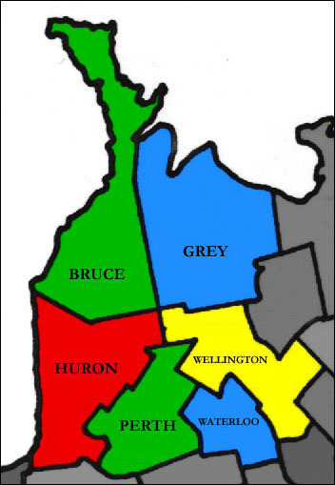
About Grey-Bruce
Grey County
4,497.93 km²
9 municipalities
Population 100,905
8% immigrants
70+ mother tongues
Bruce County
4,076.22 km²
8 municipalities
Population 73,396
7% immigrants
60+ mother tongues
Source: Statistics Canada 2021 Census Data
Notes:
Unique geography – wide-spread communities, no public transportation
Unique demographics – predominantly white, low immigrant percentage but diverse
Newcomers and immigrants concentrated in a few communities, such as Owen Sound, Port Elgin, Kincardine, Dundalk.

Slide 4
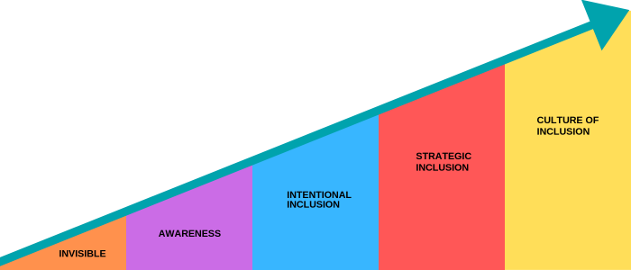
Five Levels of Inclusion – where was Grey-Brue?
Source: Toronto Metropolitan University Pressbooks
Notes:
Wide span of immigrant population: some communities have noticeable number and some have none
Especially in communities where there are only a few or no newcomers, there is low or no awareness of the need of inclusion.
Some communities started to recognize the importance of being inclusive but some are not there yet.
Level of inclusion varies across communities

Slide 5
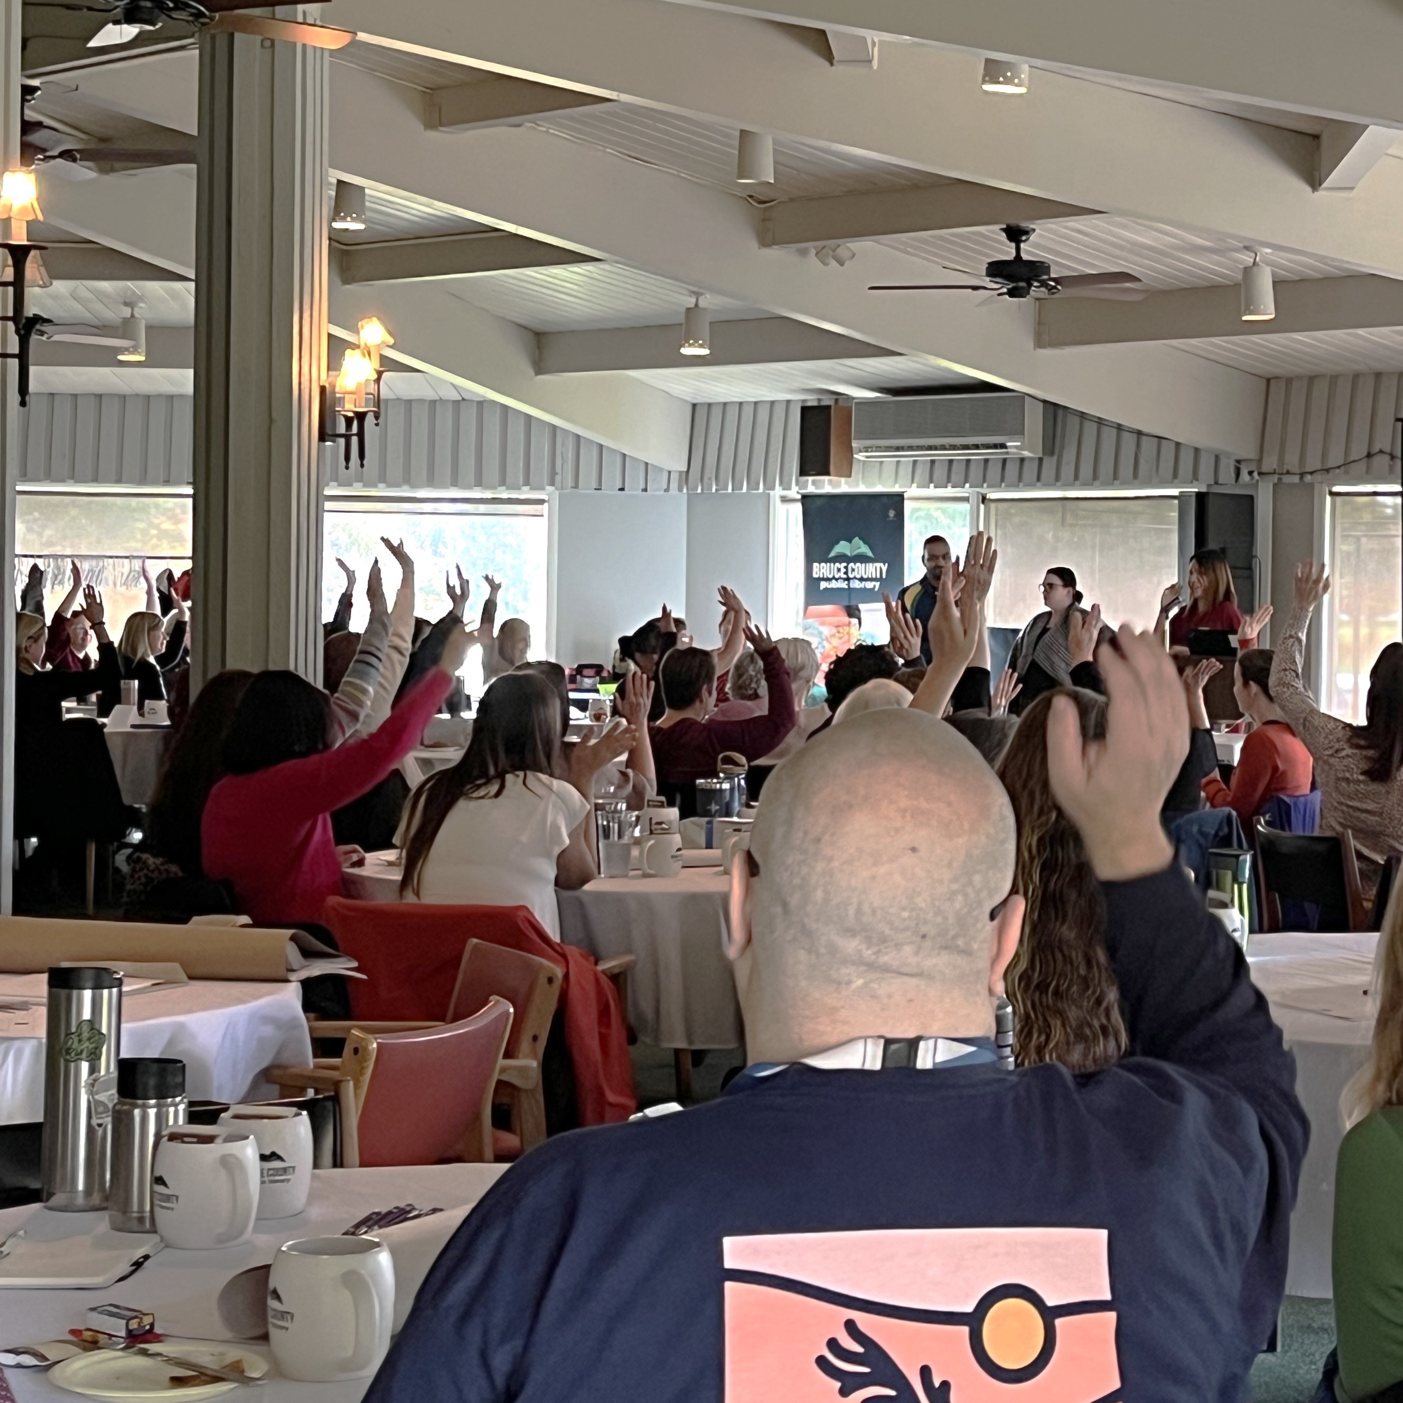
Grey-Bruce Train the Trainer: Building Capacity from Within
Purpose
Equip rural communities in Grey Bruce with the capacity to understand and share knowledge on topics of Equity, Diversity, Inclusion.
Notes:
GBLIP wanted to do a project that help foster awareness of how to be more welcoming and inclusive
submitted proposal to IRCC in 2021; funding came through at the end of the year
February 2022 to March 2023
Virtual because of COVID
Uniqueness – recruited local residents of diverse cultural background, co-created the curriculum to weave in their lived experience in a local context

Slide 6
Phases – March 2022 to December 2023
Phase 1 | Co-created “Conversations for a More Inclusive and Welcoming Community” EDI Training Curriculum
Phase 2 | Knowledge into Practice
Phase 3 | Local 7 Facilitates the Training and Evaluation
Extension | In-person training
Grey Bruce Train the Trainer: Building Capacity from Within
Notes:
Phase 1 - Local 11 worked with Impact Consulting to co-create EDI training curriculum, Conversations for a More Inclusive and Welcoming Community.
Phase 2 – Local 11 shadowed consultant who delivered virtual training to GBLIP Council members
Phase 3 – Local 7 delivered virtual training in pairs with support from consultant and GBLIP Coordinator
Delivered 23 workshops to 199 individuals from over 20 organizations
Extension – Local 6 adapted itinerary and delivery two in-person training to 40 and 60 participants

Slide 7
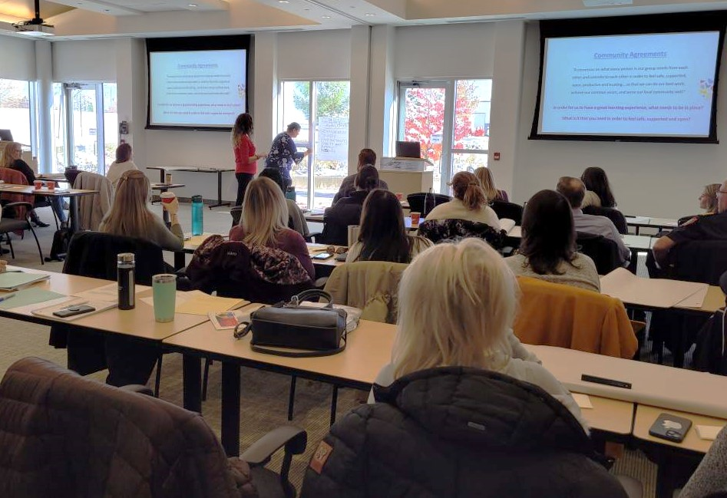
The Curriculum
Brave Space
Power & Privilege
Unconscious Bias
Microaggression
Allyship
Grey Bruce Train the Trainer: Building Capacity from Within
Notes:
Concepts covered in the curriculum: Brave Space, Power & Privilege, Unconscious Bias, Microaggression, Allyship
Workshop activities include ice breaker, developing a community agreement, breakout room/small group discussions, videos, large group sharing.

Slide 8
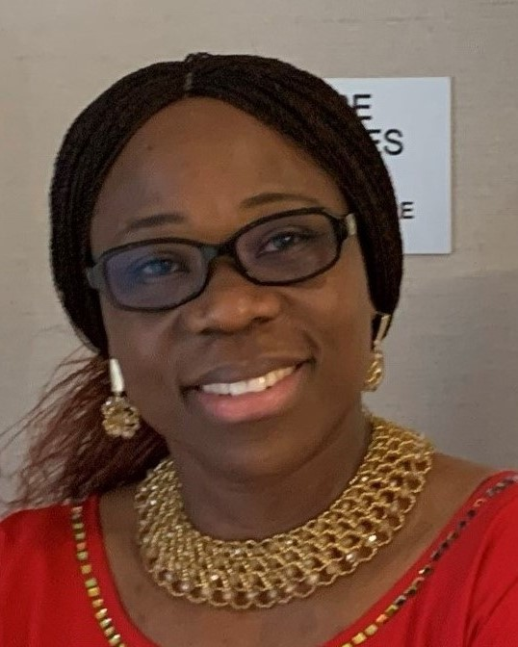
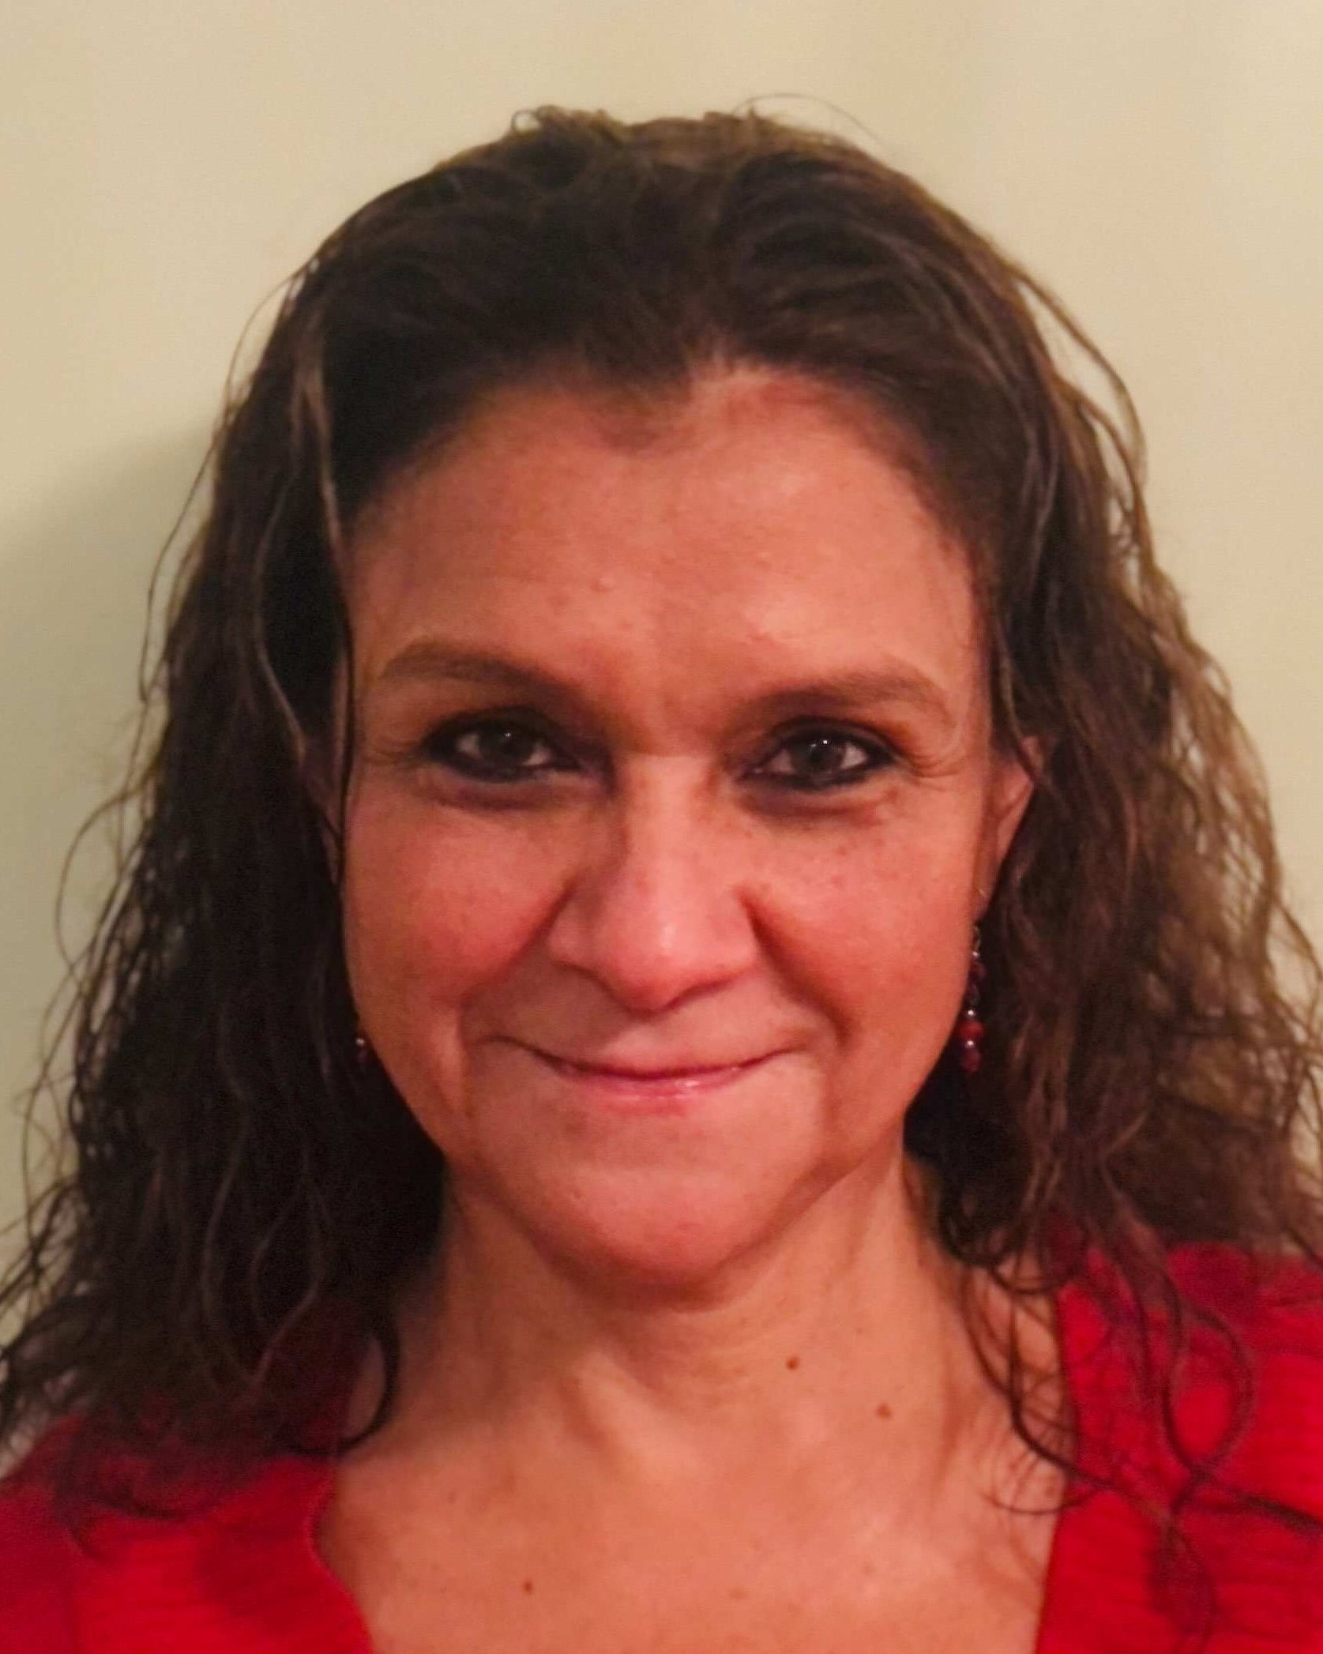
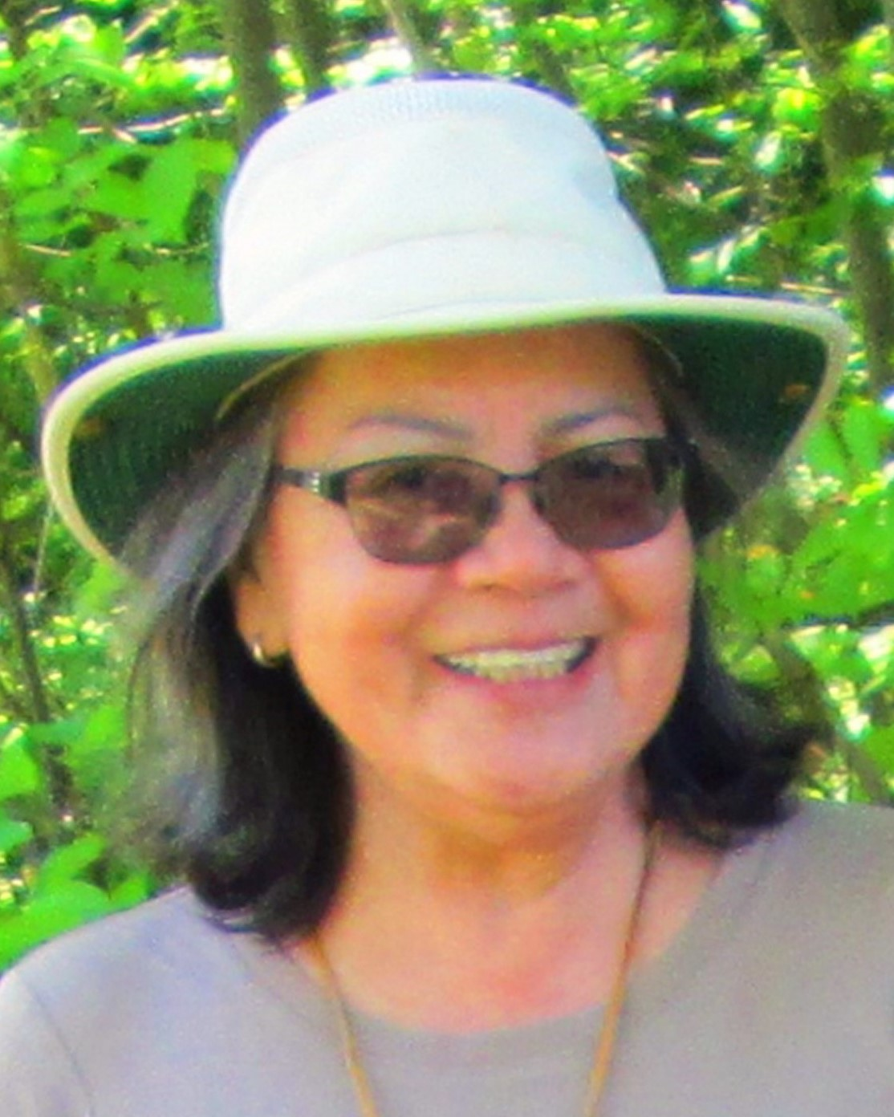
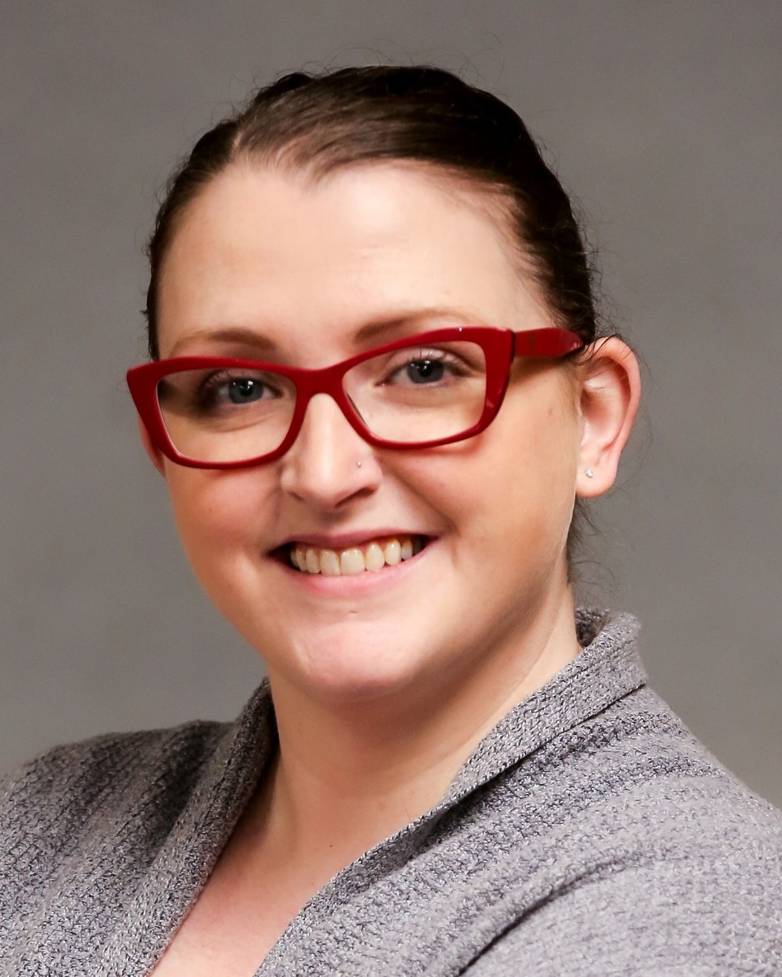
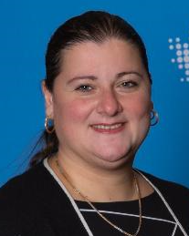
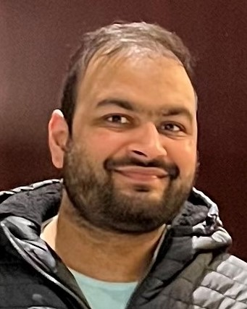
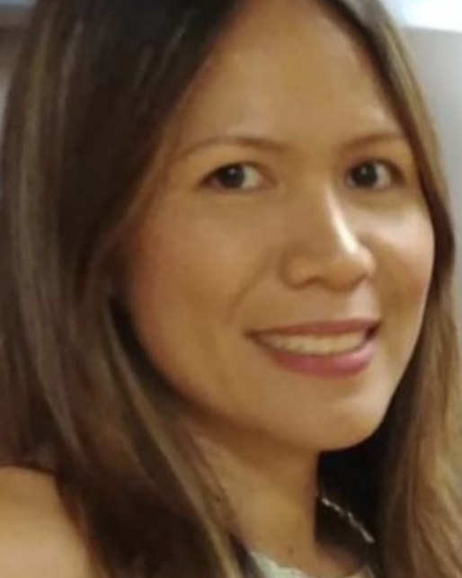
Outputs
EDI Training Curriculum
Local facilitators
Training Manual
White Paper
Charlotte Mojoko
Irma Valiente-Roman
Lenore Keeshig
Lindsey Glazier
Marina Angeli
Nitin Kumar Singla
Sharon Safra
Grey Bruce Train the Trainer: Building Capacity from Within
Notes:
• An EDI training curriculum relevant to local context
• A pool of local facilitators – diverse cultural backgrounds, lived experience
• Training manual – sustain the facilitator pool

Slide 9
Outcomes
Organizations want training for their staff
Sparked “conversations” within organizations
Better understanding of fundamentals for developing an EDI strategy
Empowered newcomers and immigrants
Grey Bruce Train the Trainer: Building Capacity from Within
Notes:
Provided virtual training to SSM Service Provider Organization staff in August and September
Have requests from municipalities and organizations about virtual and in-person training
Facilitators feels empowered – their voices are heard and can influence positive changes for other newcomers and immigrants

Slide 10
Feedback
“I will continue to learn and bring this education and discussion to the leaders and team members in my organization.”
“Have a better understanding of some of the challenges people may be facing and find ways to make them feel included and a part of the community.”
“I enjoyed hearing about different experiences. It helps us see our communities through a different lens.”
“If privilege = power. How can I use this "power" to make a difference.”
“How I go about making personal changes to be more inclusive.”
Grey Bruce Train the Trainer: Building Capacity from Within
Notes:
Read feedback

Slide 11
Best Practices
Challenges
Facilitators’ diverse cultural backgrounds and lived experiences
Co-creation of curriculum
Started with virtual delivery
Facilitators dropped out because of changes of life’s circumstances
Vulnerable when sharing stories
Resistance to change (less than 5% of all participants)
Grey Bruce Train the Trainer: Building Capacity from Within
Notes:
Best practices
Facilitators’ diverse background and lived experience – sharing stories help participants understand concepts better
Co-creation of curriculum – local context, facilitators take ownership
Challenges
Facilitators dropped out – started with 11 and ended with 7, developed training manual to sustain the facilitator pool
Worried about sharing personal stories at first in front of a group of only caucasian participants
Resistance to change (less than 5%) of all participants

Slide 12
Five Levels of Inclusion – where is Grey Bruce Now?
Source: Toronto Metropolitan University Pressbooks
Notes:
Heightened awareness because of the EDI Training.
Examples: A municipality’s strategic planner applying learning from the training when developing EDI strategic plan; volunteers from community groups intentional make their programs more inclusive after taking the training.
Moving onward – facilitators continue to provide virtual or in-person training on request, train more training when funding available.

Slide 13
Thank You ☺
Deepikaa Gupta
Manager, Grey-Bruce Local Immigration Partnership
web: www.greybrucelip.ca
email: Deepikaa.Gupta@grey.ca
Empowering Rural Ontario: Fostering Diversity, Equity and Inclusion for Sustainable Economic Development

