Slide 1
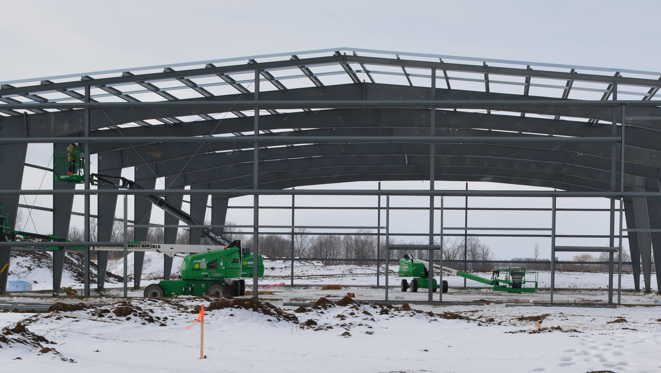
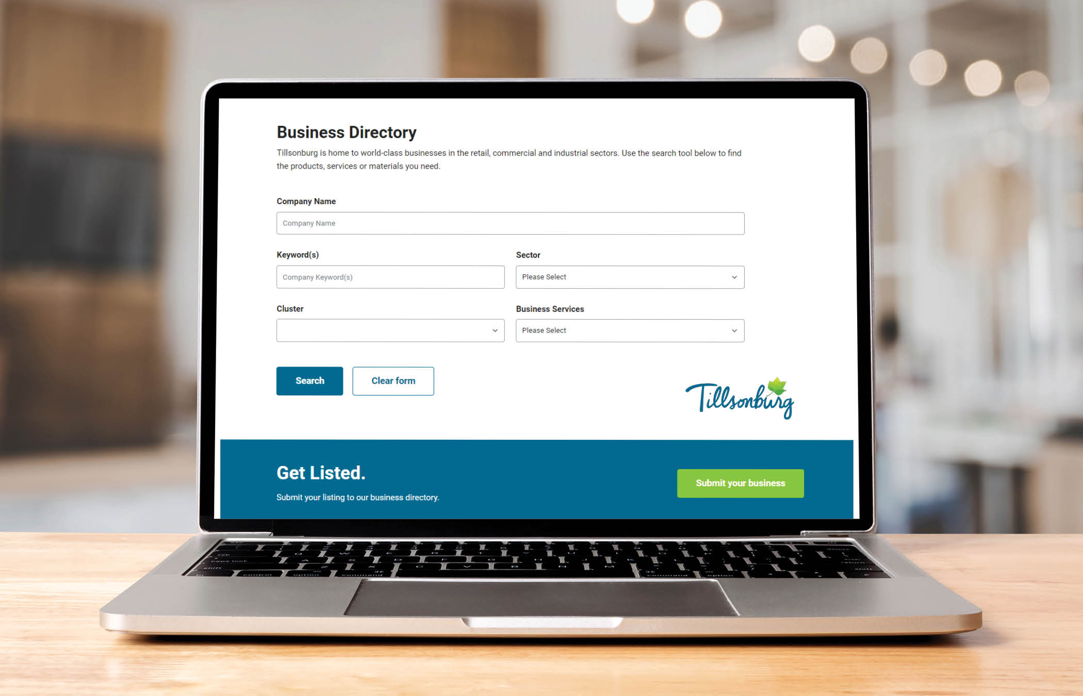
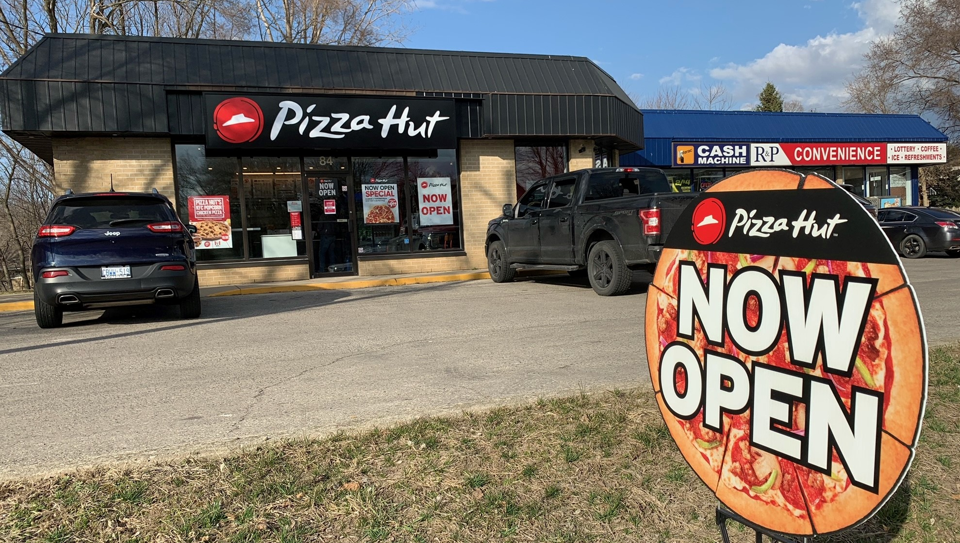
New CRM & Automated Business Directory
February 8, 2024

Slide 2
Outline
Business Retention in an Automated World
Previous CRM
Project Deliverables
Process
Outcomes
Business Directory Update
Survey Response
Next Steps
Learnings

Slide 3
Business Retention in an Automated World!
Managing business relationships is of critical importance in Economic Development!
Hence, it follows that managing business information is also critical
Notes:
Given the volume of calls, conversations, emails, financial deadlines and follow-ups, managing this information with an Excel spreadsheet and calendar functionality isn’t ideal and with the plethora of apps, the choice can seem endless
Most organizations have some form of system to track and manage their investment leads, which is obviously critical for success, but the more mundane aspect of Business Retention can play second fiddle to systems for investment attraction efforts
Ask Audience: How many people use a CRM? How many people use a CRM on a daily basis? How many people still use Excel (nothing wrong with Excel).
This is an oversight as the common axiom is that Economic Development investment follows the 80:20 rule. Even if this rule isn’t quite right, business and investment retention can’t be overlooked (St Thomas example of VW versus existing expansions)

Slide 4
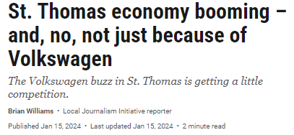
Business Retention in an Automated World!
Notes:
This is an oversight as the common axiom is that Economic Development investment follows the 80:20 rule. Even if this rule isn’t quite right, business and investment retention can’t be overlooked (St Thomas example of VW versus existing expansions)
The city that landed a $7-billion electric-vehicle battery plant (186,000m2 or 2,001,360 ft2) has also seen major manufacturing investment that has nothing to do with the German automaker, including more than 55,700 square meters (600,000 square feet) of new development on 16 hectares of local industrial land.
“Almost every industry or manufacturer in St. Thomas is in some sort of growth-forward mode, and we’re trying to accommodate all we can,” said St. Thomas Mayor Joe Preston.
There could be 1.5 million sq ft (140,000 sq m)
https://lfpress.com/news/local-news/st-thomas-economy-booming-and-no-not-just-because-of-volkswagen

Slide 5
Business Retention in an Automated World!
But, does automated always mean better???
Death by app???
How does one balance personal/impersonal, cost/efficiency, business retention/attraction, etc???
Notes:
It’s easy to let what’s expedient or easy overtake that which is best (at least in the long term) for your organization. Really, the holy grail is the modern call centre where every interaction is tracked and responded to regardless of the channel used. But, call centres can be, well, so impersonal and cold

Slide 6
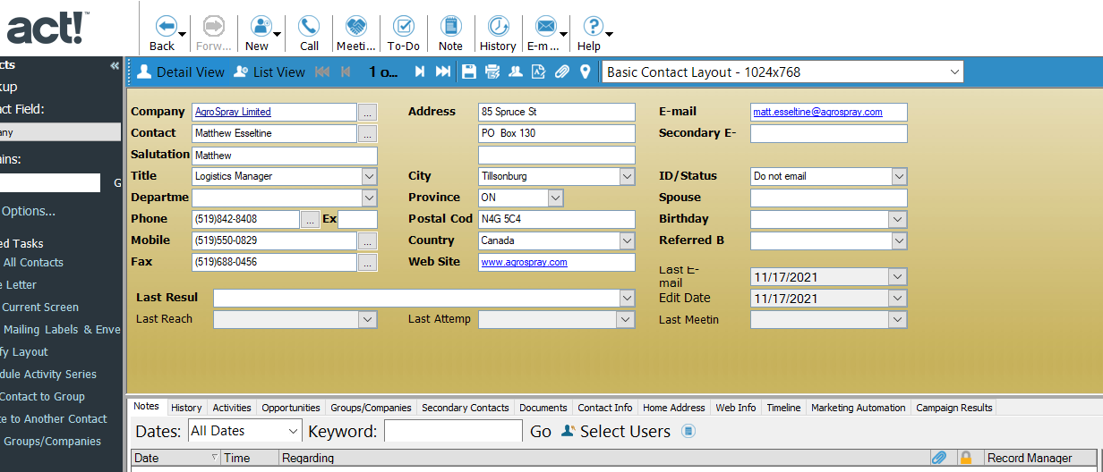
Previous Customer Relationship Management (CRM) System
Good data repository (save and retrieve) Large database of ~ 7000 records
15 years of record keeping
Notes:
• Act! Has served the dep't – primary purpose has been a data repository – (save & retrieve)

Slide 7
Previous CRM
No connection between CRM and online Business directory
Fewer and more costly options for integration with marketing tools such as social media, forms, surveys, email campaigns, etc.
Limited data-driven marketing insights
Notes:
CRM’s have evolved & EcDev teams place higher demands on integration features
• Act! wasn’t meeting the department’s needs
Updating the Business Directory was a time-consuming, manual process, involving data entry from paper surveys and periodic exports of data from the Act! CRM into spreadsheets, and sent to the County for upload
Difficult to maintain timely business information

Slide 8
Project Deliverables
The project included three deliverables:
Client Relationship Management System - to continue to manage accounts and contacts that the Economic Development team engages, as well as to track investment leads, meetings, and changes in economic performance
Business Directory – a public-facing Business Directory that is connected to the CRM and allows selected records to be displayed for the public
Company Updating – an automated updating process for companies to add themselves or update their information in the public-facing business directory and the CRM

Slide 9
Process
RFP
Data Preparation & Export/Import
CRM and BD
Design & Development
Test Phase
Launch
Q4 2022 Q1 2023 Q1-Q2 2023 Q3 2023 Q4 2023
Awarded to “The Local Option”
Zoho CRM selected
Data clean-up
Export from Act! and reformat for Zoho import
Customization of search options, categorization, layout
Automation and integration of CRM & BD
Staff training
Survey and template development
Internal testing and review
Test launch to 15 select accounts
Phase 1: Launched to 351 accounts by email
Phase 2 (2024): Target remaining accounts
Notes:
High level look at the project process

Slide 10
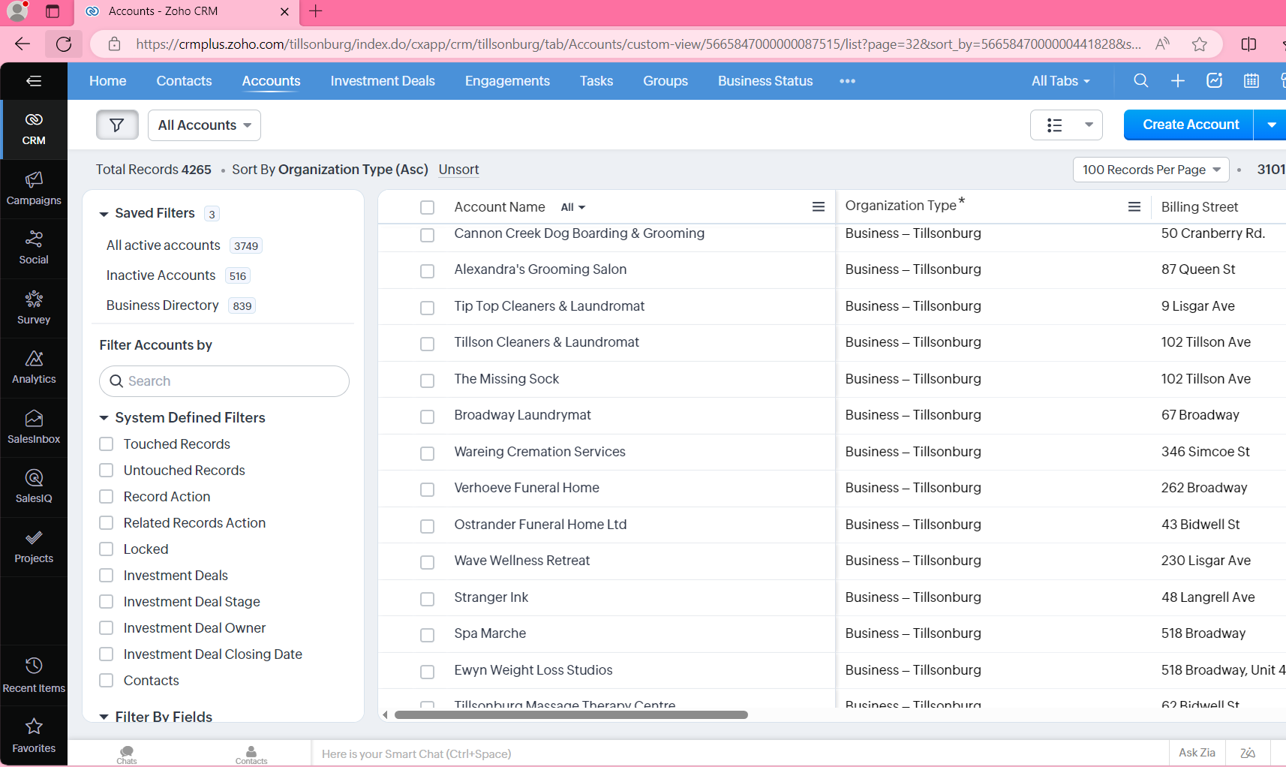
Outcome
CRM
Town’s Zoho CRM contains:
6,153 active contacts (6,876 total)
3,758 active companies (4,265 total)
839 companies in the Business Directory
Notes:
The data review/clean-up performed before importing records into the new Zoho CRM improved the overall accuracy of company and contact information

Slide 11
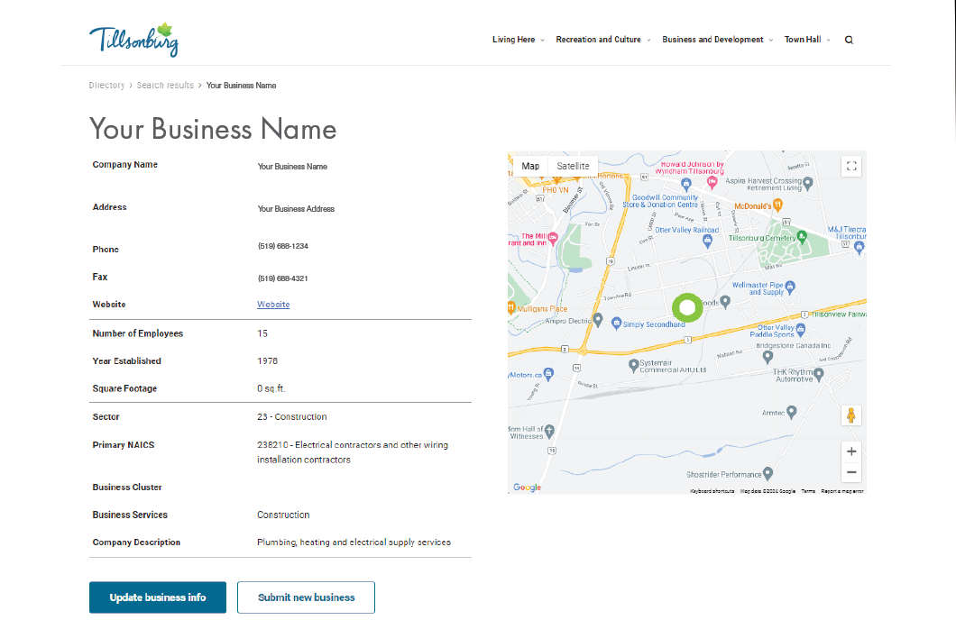
Outcome
Intelligent automation: 2-way communication between the CRM and BD
CRM
BD
INTERNAL
PUBLIC
businessdirectory.tillsonburg.ca

Slide 12
Outcome
Automated updates
BD
Changes to public Business Directory within 24 hrs
Businesses can update their online listing, or add a new business, at any time
Online submissions are “parked” for Town staff to review and approve before publishing

Slide 13
Outcome
Tracking:
Integration:
CRM
Email Campaigns
Outlook Email
Surveys
Social media
Web forms
Engagements
Investment Deals

Slide 14
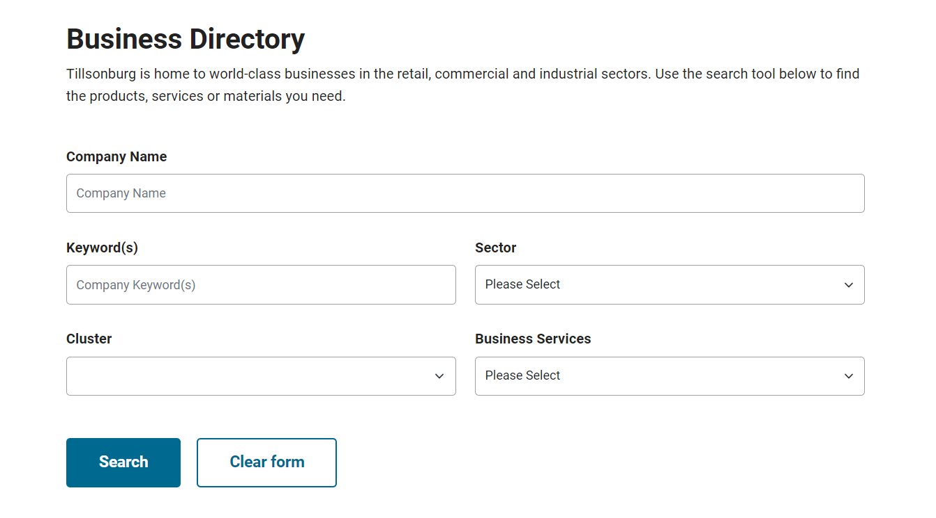
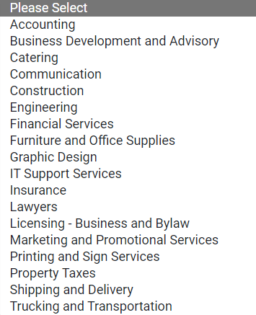
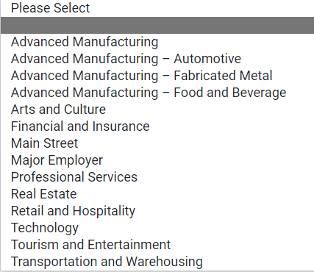
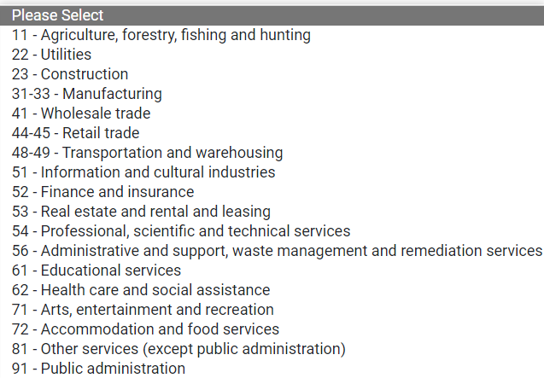
Outcome
Outcome
BD Landing Page
Search by:
Company Name
Keywords(s)
Sector
Cluster
Business Services

Slide 15
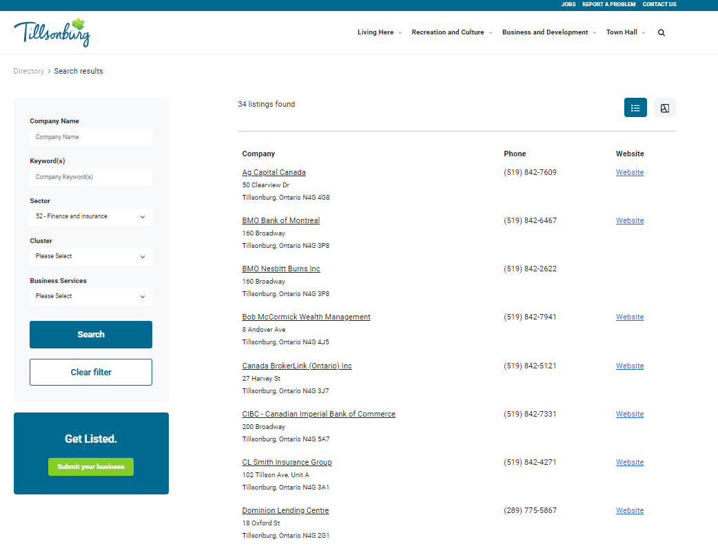
Outcome
Outcome – Search Results

Slide 16
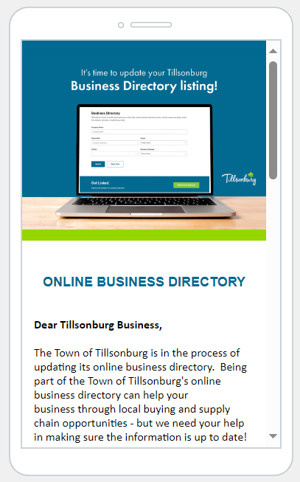
Business Directory Update
(Q4 2023) Business Directory updates made via an online Business Survey
Business Directory contacts were emailed a link to the pre-populated Business Survey form
Completing the Business Survey updates the online BD listing
Multiple email reminders
Prize offered ($100 gift card) to complete the survey by the deadline

Slide 17
Survey Response
839 accounts (companies) in the Business Directory
Q3 2023
TEST • 15 accounts
• Business Survey sent to 15 test accounts
Q4 2023
INITIAL LAUNCH
• 351 accounts
• Emailed survey (3x) to 351 account contacts • 100 surveys completed (28% response rate)
Q1 2024
LAUNCH
• Target the balance of accounts (488)
• Launch marketing campaign / PR to promote BD to business community
Notes:
28% response rate (351 accounts sent survey/ 100 completed surveys)
12% of all businesses in the BD have updated their listing (839 accounts in BD / 100 completed surveys = 12%)

Slide 18
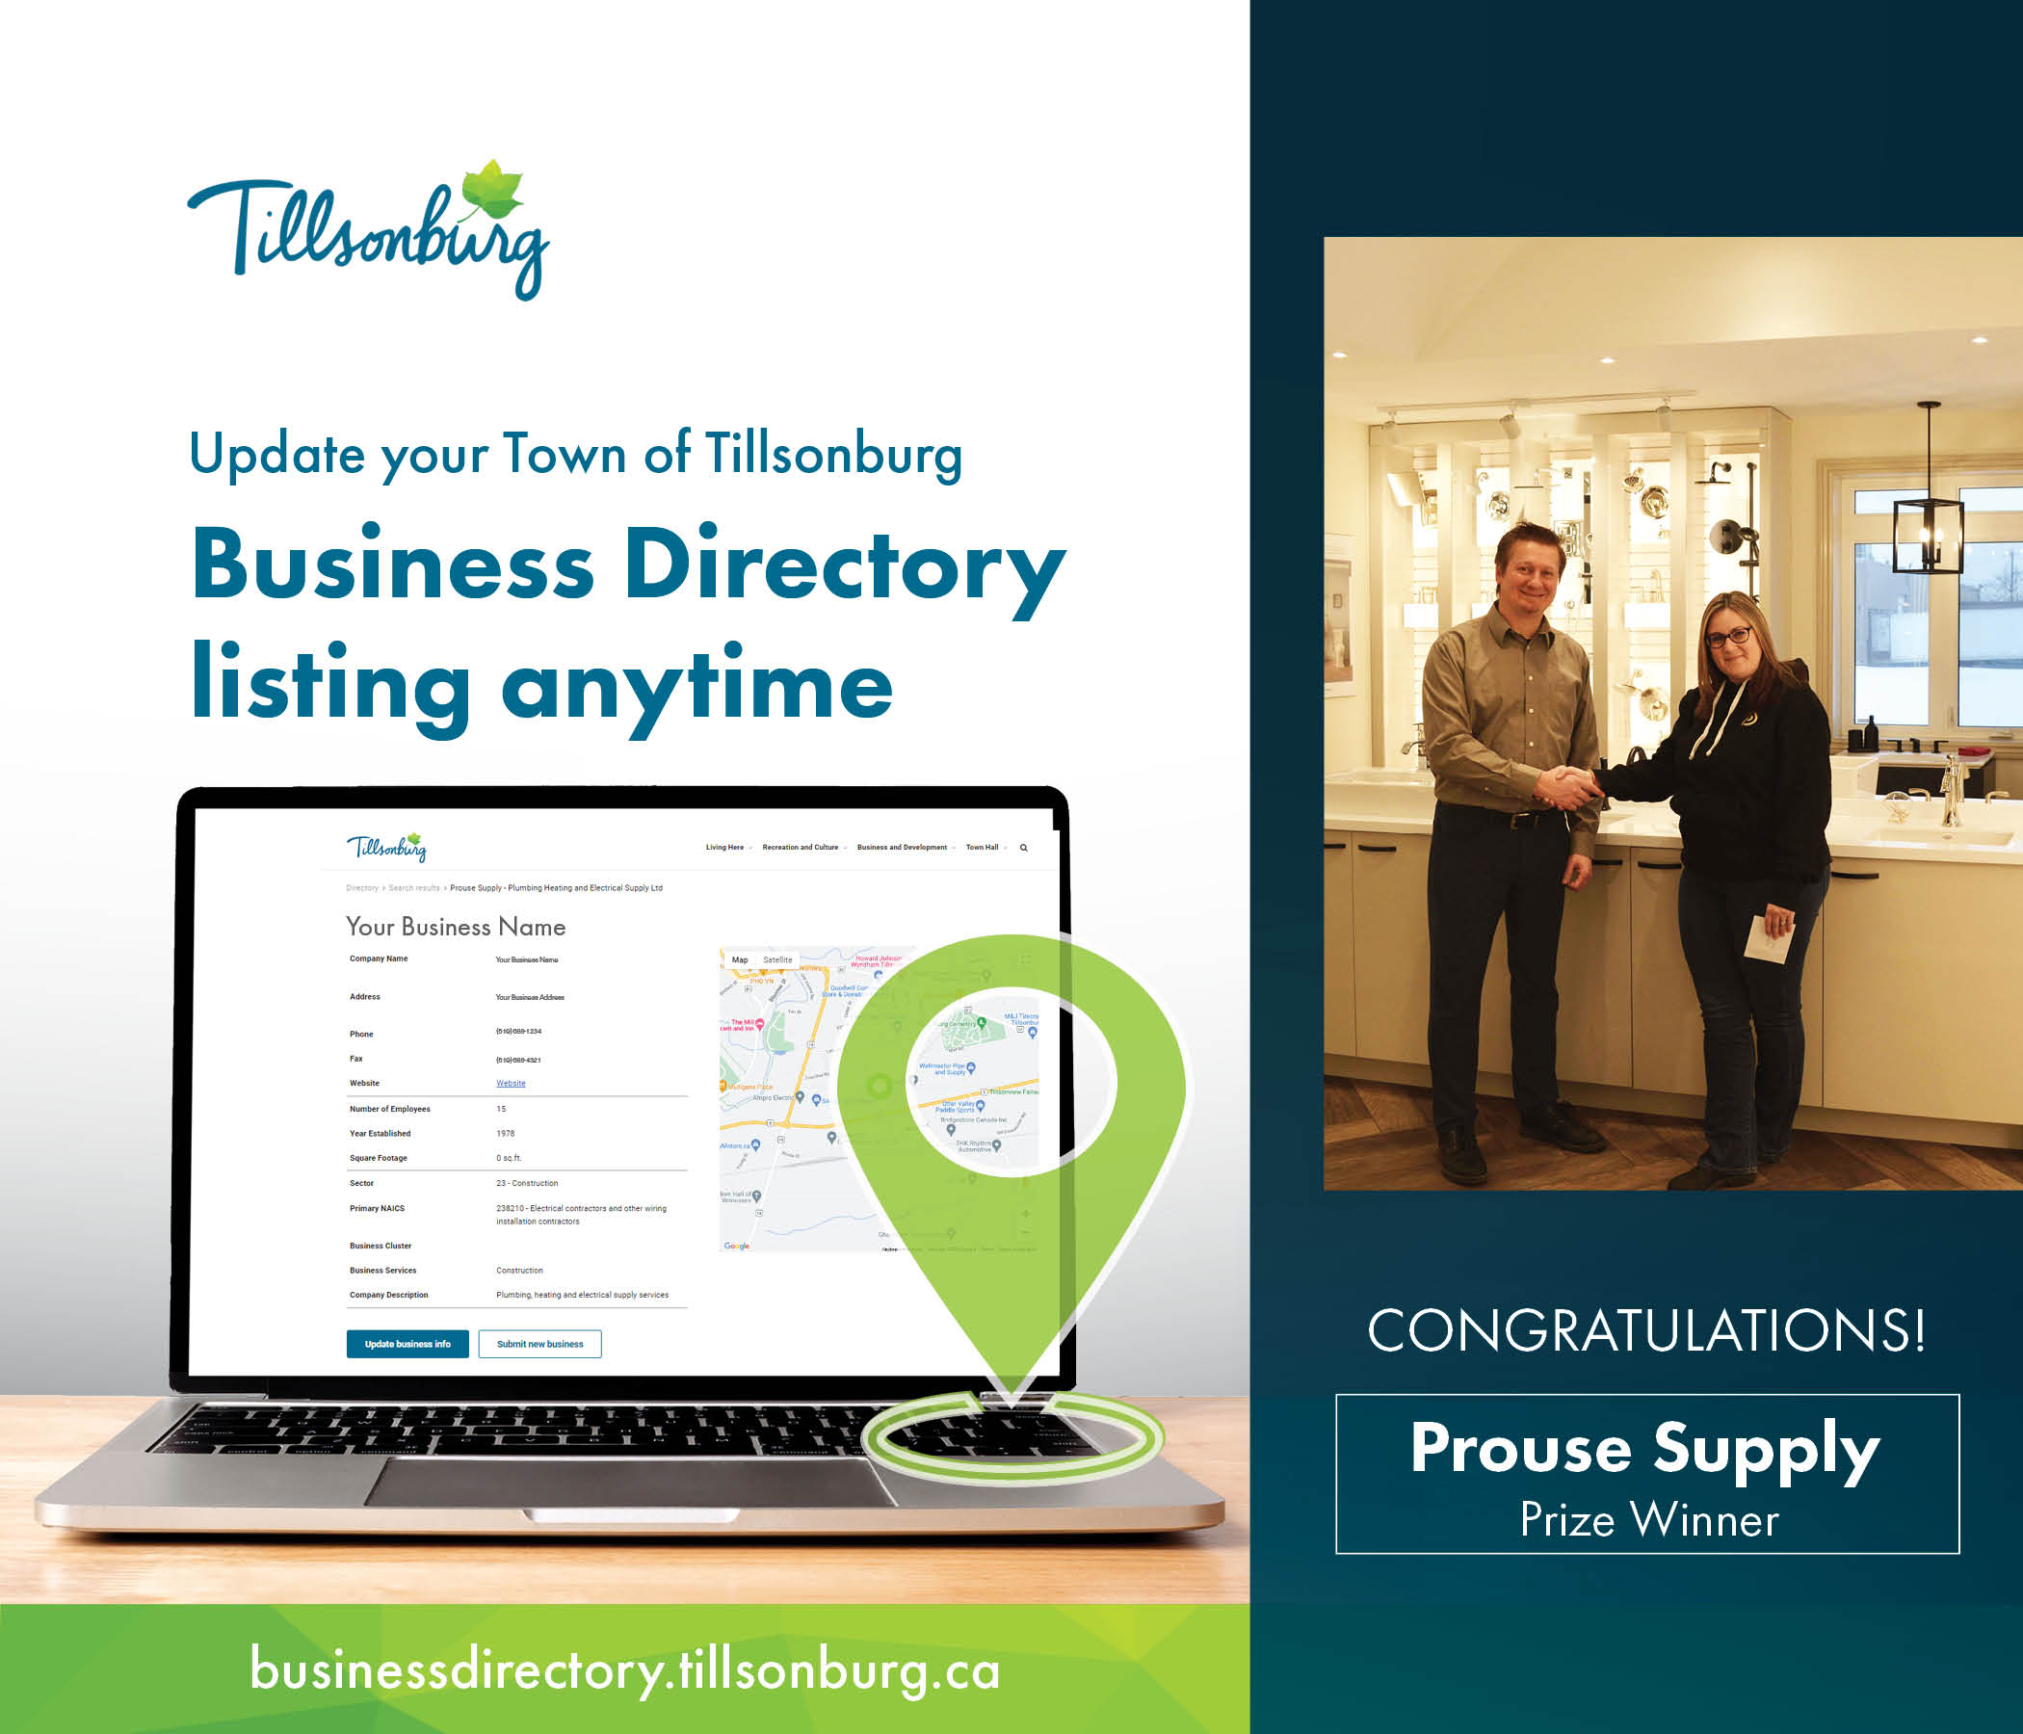
Notes:
-Draw prize for $100 gift card to a Tillsonburg restaurant of choice
-Winner drawn from 100 companies who qualified (completed survey by Dec 8)

Slide 19
Next Steps
Business Directory:
Continue to build out customizations
Launch marketing campaign to promote the Business Directory to all businesses
Public awareness marketing campaign
Customer Relationship Management:
Continue to enhance/develop automations
Real-time use of database
Find balance of automation/personal touch
Explore integrations with partner agencies (SOMA)
Enhance partner use of CRM (SOMA)
Notes:
Supply

Slide 20
Learnings:
Don’t be afraid! (as long as you have a good consultant)
Customization is key
But recognize that no system is perfect
Don’t lose sight of the importance of personal touch
“We” still have further to go
Notes:
Some people get FOMO, I get FOLD (Fear of Losing Data)

Slide 21
Thanks to:
Ontario Municipal Modernization Program
The Local Option (www.thelocaloption.com)
Notes:
~ 66% of funding came from the MMP
Estimated $40K in Cost Savings and Efficiency Gains over the first 3 years!
This equates to 10% of my annual budget

Slide 22
THANK YOU
New CRM & Automated Business Directory
Town of Tillsonburg Economic Development & Marketing

