Slide 1
Shifting Gears & Economic Development Priorities - What are you doing for me now?
The World has Changed, Economic Development 2024: A New Approach to Economic Development.
OR
What is Old is New Again and Some Things Never Change.

Slide 2
Agenda
Speaker Introductions
Trends
Top Trends in Site Selection
Manufacturing Priorities
Changes
What Eastern Ontario EDO’s are saying
Perspectives from Ontario, Canada and the World
What Hasn’t Changed and Preparing for the Future
Interactive Discussion

Slide 3
Your Presenters
Dave Paul, Ec.D (F), Principal, Quaich Business Services, Director, Economic Development, City of Brockville (retired)
Jay Amer, Ec.D., Executive Director, Ontario East Economic Development Commission, President, Amer & Associates Economic Development
Chris King, Ec.D., CEO, Quinte Economic Development Commission
Magic Numbers: 50, 26, 30
Respective Years as EDOs - 💯+

Slide 5
Quinte Economic Development Commission (QEDC) Belleville, Quinte West, Brighton
when first started in 1995
TODAY
High unemployment, closure of unionized plants, very little wage pressure
Plenty of vacant land
Available buildings
Where is Bay of Quinte, where is Eastern Ontario
Take what we could get
Manufacturing perception
Lots of jobs to go around, upward wage pressure
Lack of investment-ready industrial land
Available Industrial buildings turnover quickly
Many clients come to us already knowing the value proposition. Influencers know us too.
We can be more selective – focus on high-value projects
Manufacturing perception is changing

Slide 6
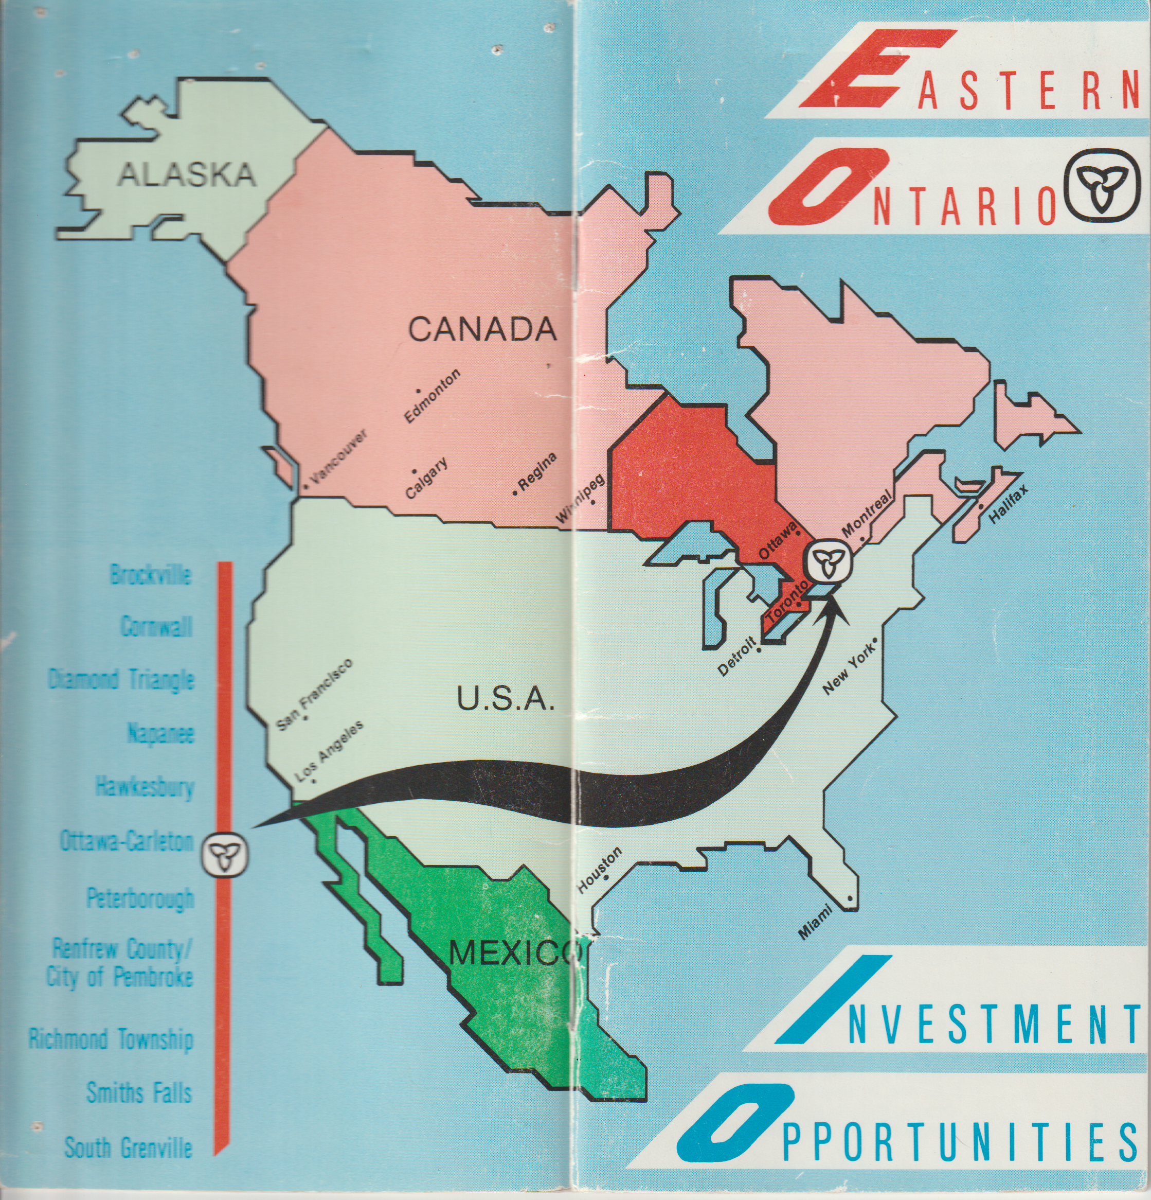
Ontario East Economic Development Commission
Established in 1988 – 10 Members
TODAY – 150 MEMBERS

Slide 7
Top Trends in Economic Development
Proximity to Talent Hubs
Resilience and Risk Mitigation
Sustainable Practices
Impact of Work from Home
Data Infrastructure & Connectivity
Global Supply Chain & E-Ecommerce Growth
Tax & Economic Incentive Considerations
Real Estate Conditions
Health & Wellness Focus
Community Engagement & Social Impact
Source: Trends in Corporate Site Selection – King White, Site Selection Group

Slide 8
Trend: Global Supply Chain and E-Commerce Growth
The global supply chain was impacted significantly during the COVID pandemic, causing many companies to rethink their global supply chain and reliance on countries such as China.
In addition, the surge in e-commerce has elevated the importance of strategically located distribution centers.
Growth companies are more focused on selecting sites that facilitate efficient supply chain management, reducing delivery times and operational costs, avoiding future disruptions.
Example: Trafford Park, Manchester England.
:

Slide 9
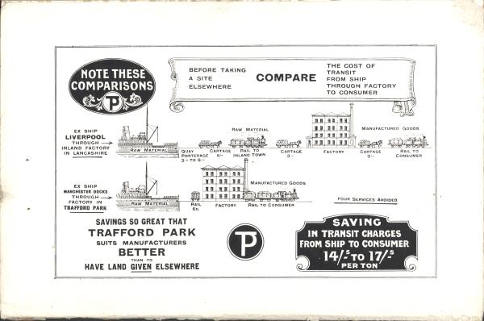

Slide 10
Trend: Health and Wellness Focus
Employee well-being has taken center stage in corporate culture. Companies are selecting locations and buildings that promote employee health and wellness with considerations for access to recreational spaces, healthcare facilities and work-life balance.
The “live, work and play” and “flight to quality” approach has become critical for office-related projects in the site selection process.
Example: Napanee, Ontario

Slide 11
Trend: Real Estate Conditions
It is a tale of two real estate types: the supply and demand of office versus industrial real estate for site selection projects. For office-related site selection projects such as headquarters, software engineering and contact centers, there is ample supply of options available due to high vacancy and sublease availability.
Conversely, the availability of quality industrial warehouses and manufacturing real estate is more challenging. There is currently a significant shortage of large land sites for manufacturing projects that have adequate infrastructure. Similarly, the availability of modern warehouse space has been low due to supply chain shifts and e-commerce sector growth.
Example: Napanee, Ontario

Slide 12
Recommendations from CME
Four Main Pillars from Manufacturing Canadians Future
Expand and Upskill the Manufacturing Workforce
Stimulate Innovation, Investment and the Adoption of Advanced Technologies
Encourage Domestic Production and Value-Added Exports
Speed up and Expand Clean Technology Incentives to Help Manufacturers Adapt to Advance Canada’s Climate Change Plan
SOURCE: CME December 2023

Slide 13
What has changed
Tools used by EDOs
Availability of data to site selectors and companies. No need to contact EDO
Value proposition is already well known before clients speak to us
Lack of availability and price of industrial land
Programs not always keeping up with the trends
Need to relaunch previously successful older programs.
Regulatory burden / regulatory bodies
Manufacturing seems to be cool again
Labour availability and skill challenges
Pace of Projects
Holistic approach to economic development in housing, daycare, medical recruitment, immigration
Inclusion of groups that were traditionally not included in economic development (indigenous)
Increase of females in the profession
Focus on clean energy and environmental sustainability
Artificial intelligence as a tool in economic development

Slide 14
What has not changed
Building Relationships
Collaboration, Trust
Remember who are your customers – council, community, residents, businesses
Business fundamentals driving business decisions (the weighting of the factors changes but the fundamentals still apply)
Customer Service Approach
Trends do not always mean long term opportunities (call centres, solar/wind projects, cannabis/EV?)
Try and react at the speed of business
“Fish where the fish are”
Navigating (avoiding) Politics
Economic Development is a team sport, share the glory.
The graveyard is full of the bones of indispensable people – Don’t forget to take time to have some fun along the way
Most economic development presentations seem to contain these phrases, so we’ve included them too:
Perfect storm, Let’s try and unpack this, Granular level, Peel back the layer of the onion, Value-proposition, Return on investment, Low-hanging fruit, Quick win, Looking through lenses, Sally forth

Slide 15
Thank You! Dave, Chris and Jay
100+ Years of Progress

